Slide 1
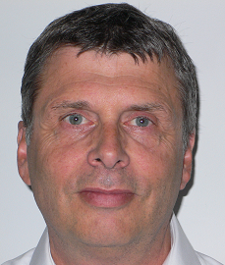
Franck Surdeau
Senior ABAP Programmer
Profile
References
14+ years experience in IT
Languages: French (mother tongue), English (Written, Read)
DGAC – SAP Implementation / Technical Consultant (1 month)
Modified In-Out interface programs
Created Out interface programs based on BI extractors
Wrote technical specifications
CASINO – Specifications implementation / Technical Consultant (5 months)
Created interfaces with an ETL (Extract-Transform-Load)
Created BADI
Wrote technical specifications
Tools: ABAP, BADI, Function Modules
DAIKIN – Application Maintenance / Technical-Functional Consultant (4 months)
Modified interface between ECC and CRM
Designed archiving program for PDF documents
Modified specifications
Wrote technical specifications
Tools: ABAP, IDOC, User exit, BAPI
DAIKIN – Application Maintenance / Technical Consultant (6 months)
Designed data extraction programs
Designed a purchase request form
Tools: ABAP, IDOC, User exit, BAPI, SMARTFORMS
TELEFLEX – Application Maintenance / Technical Consultant (16 months)
Created specific programs
Wrote technical specifications
Application Maintenance Support
Key Competences
ABAP , IDOC, BAPI, LSMW, SMARTFORMS, QUERIES Expert
Customer training and support
Programming, forms, function modules
Application maintenance
Experience
Public Sector: DCSSA,
Industry Sector: Daikin, Saint-Gobain
Retail Sector: Casino
High Tech: Siemens
Automobile: Delphy, Teleflex, Tepcos

