Slide 1
Lecture 1 on
Object Oriented Modeling with UML by
Ramakant Soni
Assistant Professor
Dept. of Computer Science
B. K. Birla Institute of Engineering & Technology

Slide 2
Objectives of the module
Objective 1:
This course is to learn modeling and design programs using the object approach. The language used is UML.
Objective 2:
To provide a software development methodology starting the real world until the completion of the program
Objective 3:
Learn how to design objects in view of reusability.
Notes:
This pillar of object-oriented programming is usually called inheritance, but inheritance is actually one of several techniques for achieving the broader goal of reusability.
Reusability means being able to create a new class that uses the features of an existing class without recoding those features. There are actually several ways to achieve reusability in object-oriented programming.
Inheritance means reusing code in a hierarchical structure. For instance, a BasicProgrammer is a Programmer is a Worker is a Person is an Animal. All Animals have heads, and therefore the Head property of a BasicProgrammer should inherit all the general features of Animal heads plus all the features of Person heads plus all the features of Worker heads plus all the features of Programmer heads. When creating a Head property for a BasicProgrammer object, you should need to write only the head code unique to BasicProgrammers.

Slide 3
What is a Model?
Definition 1:
In (computers) Model is a simulation to reproduce behavior of a system.
Definition 2:
It’s the representation of entities and relationships between them.
Definition 3:
A model serves as an abstraction - an approximate representation of the real item that is being built.
Notes:
Simulation is the imitation of the operation of a real-world process or system over time. The act of simulating something first requires that a model be developed; this model represents the key characteristics or behaviors/functions of the selected physical or abstract system or process. The model represents the system itself, whereas the simulation represents the operation of the system over time.

Slide 4
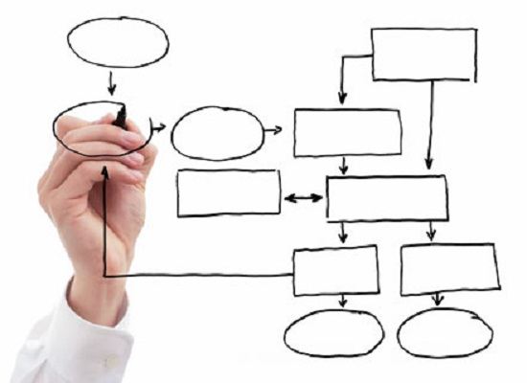
What is modeling?
Definition 1:
Process of representing a real-world object or phenomenon as a set of mathematical equations.
Definition 2:
Designing and analyzing a mathematical representation of an economic system to study the effect of changes to system variables.

Slide 5
Why to model?
It is neither technically wise nor economically practical to build certain kind of complex systems without first creating a design, a blueprint or another abstract representation.
For example : Professional architect needs to first develop an array of architectural plans before constructing a multi-office building.
Modeling provides architects and others with the ability to visualize entire systems, assess different options and communicate designs more clearly before taking on the risks- technical, financial or otherwise of actual construction.

Slide 6
When do we model?
Some specific situations in which the modeling effort is worthwhile include:
To better understand the business or engineering situation at hand ("as-is" model) and to craft a better system ("to-be" model).
To build and design a system architecture.
To create visualizations of code and other forms of implementation .
Notes:
As-is Model: Simulation that represents the current situation as it is, without incorporating any changes or improvements.
To-Be Model: Model that results from incorporating improvements in the current (as is) model.

Slide 7
How do We model?
A standard means for representing software models and related artifacts.
Software architects, designers and developers use UML for specifying, visualizing, constructing and documenting all aspects of a software system.
Key leaders from IBM Rational led the original development of UML. Today, UML is managed by the Object Management Group (OMG), which ensure that the specification continues to meet the dynamic needs of the software community.
UML is more than just a graphical notational standard -- it is a modeling language.
As with all languages, UML defines syntax (both graphical and textual) and semantics (the underlying meanings of the symbols and text). Having a true modeling language rather than just a standard notation is essential for standardizing the use of UML. UML -- a true modeling language -- has helped it become the software industry's most recognized and widely applicable modeling standard.
Notes:
About IBM Rational:
As one of the five brands within IBM Software Group, Rational provides products, services, and guidance for software and systems development and delivery. Covering the entire project lifecycle from design to deployment, IBM Rational offerings concentrate decades of experience and know-how to help teams collaborate more effectively.
IBM Rational provides a rich set of capabilities delivered as part of a collaborative and integrated range of products.
Artifact (software development), one of many kinds of tangible byproducts produced during the development of software

Slide 8
Objects
Objects are key to understanding object-oriented technology.
If we look around right now and we'll find many examples of real-world objects: our book, desk, laptop, or phones.
Software objects are conceptually similar to real-world objects: they too consist of state and related behavior.
An object stores its state in fields/ variables and exposes its behavior through methods/ functions.

Slide 9
Object Responsibilities
Objects (classes) have responsibilities, which they are expected to exhibit in an object-oriented information:
What they know about themselves -: (Attributes)
What they do -: (Operations)
What they know about other objects -:(Class and object relationships )
Notes:
Attribute is the characteristic of an object

Slide 10
Object Oriented Modeling
Object-oriented modeling is an approach to modeling an application that is used at the beginning of the software life cycle when using an object-oriented approach to software development.
Object-oriented modeling is typically done via use cases and abstract definitions of the most important objects. The most common language used to do object-oriented modeling is the Object Management Group's Unified Modeling Language (UML).

Slide 11
Object Oriented Concept
Following are some fundamental concepts of object oriented world:
Objects: Objects represent an entity and the basic building block.
Class: Class is the blue print of an object.
Abstraction: Abstraction represents the behavior of an real world entity.
Encapsulation: Encapsulation is the mechanism of binding the data together and hiding them from outside world.
Inheritance: Inheritance is the mechanism of making new classes from existing one.
Polymorphism: It defines the mechanism to exists in different forms.

Slide 12
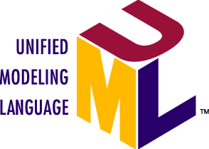
UML
The key thing to remember about UML is that it is designed to be universal, it is intended to be independent of implementation platform. Specifically it is a PIM, a platform-independent model.

Slide 13
Unified Modeling Language (UML)
UML is a general-purpose modeling language in the field of software engineering, which is designed to provide a standard way to visualize the design of a system.
It was created and developed by Grady Booch, Ivar Jacobson and James Rumbaugh at Rational Software during 1994–95 with further development led by them through 1996.
In 1997 it was adopted as a standard by the Object Management Group (OMG), and has been managed by this organization ever since. In 2000 the Unified Modeling Language was also accepted by the International Organization for Standardization (ISO) as an approved ISO standard. Since then it has been periodically revised to cover the latest revision of UML.

Slide 14
4 parts to the UML 2.x specification:
The Superstructure that defines the notation and semantics for diagrams and their model elements.
The Infrastructure that defines the core meta-model on which the Superstructure is based.
The Object Constraint Language (OCL) for defining rules for model elements.
The UML Diagram Interchange that defines how UML 2 diagram layouts are exchanged.
Notes:
Metamodel or surrogate model is a model of a model.
In computer science, the term semantics refers to the meaning of languages, as opposed to their form (syntax)

Slide 15
Design/Usage
Software development methods
UML is not a development method by itself; however, it was designed to be compatible with the leading object-oriented software development methods of its time.
UML diagrams represent two different views of a system model:
Static (or structural) view: emphasizes the static structure of the system using objects, attributes, operations and relationships.
Dynamic (or behavioral) view: emphasizes the dynamic behavior of the system by showing collaborations among objects and changes to the internal states of objects.
Notes:
Modeling
It is important to distinguish between the UML model and the set of diagrams of a system. A diagram is a partial graphic representation of a system's model. The set of diagrams need not completely cover the model and deleting a diagram does not change the model. The model may also contain documentation that drives the model elements and diagrams (such as written use cases).
The structural view includes class diagrams and composite structure diagrams.
This Behavioral view includes sequence diagrams, activity diagrams and state machine diagrams.
UML models can be exchanged among UML tools by using the XML Metadata Interchange (XMI) interchange format.

Slide 16
Applications of UML
UML is very powerful modeling language. We can develop many diagrams using UML and provide users with ready-to-use, expressive modeling examples.
UML can be applied in many areas like embedded systems, web applications, commercial applications etc.
Some UML tools generate program language code from UML.
UML can be used for modeling the whole system independent of platform language.
UML gives us a standard way to write a system's view, covering conceptual things such as business processes and system functions, as well as things like classes written in a specific programming language, database schemas, and reusable software components.

Slide 17
Areas where UML is effectively used
UML has been used effectively in following areas:
Enterprise information systems.
Banking and financial services.
Telecommunications.
Transportation.
Defense.
Retail.
Medical electronics.
Science and Research.
Distributed Web-based services.
Notes:
An enterprise information system (EIS) is any kind of information system which improves the functions of an enterprise business processes by integration.

Slide 18
Why modeling with UML is used
Modeling provides structure for problem solving.
If we model a system, we may find multiple solutions.
Modeling helps us manage the complexity of systems before actually starting development work.
With various diagrams from UML we can show clear views of system thus reducing time-to-market for business problem solutions.
If we model any problem before its development there are fewer chances that our development plan will go wrong, thus decreasing development costs.
Modeling reduces the risk of mistakes.

Slide 19
Design examples:
Taxi service - Workflow diagram
"A taxicab, also known as a taxi or a cab, is a type of vehicle for hire with a driver, used by a single passenger or small group of passengers often for a non-shared ride. A taxicab conveys passengers between locations of their choice. In modes of public transport, the pick-up and drop-off locations are determined by the service provider, not by the passenger, although demand responsive transport and share taxis provide a hybrid bus/taxi mode. There are four distinct forms of taxicab, which can be identified by slightly differing terms in different countries:
(1) Hackney carriages also known as public hire, hailed or street taxis, licensed for hailing throughout communities.
(2) Private hire vehicles, also known as minicabs or private hire taxis, licensed for pre-booking only.
(3) Taxi buses, also known as Jitneys, operating on pre-set routes typified by multiple stops and multiple independent passengers.
(4) Limousines, specialized vehicle licensed for operation by pre-booking. Although types of vehicles and methods of regulation, hiring, dispatching, and negotiating payment differ significantly from country to country, many common characteristics exist.“

Slide 20
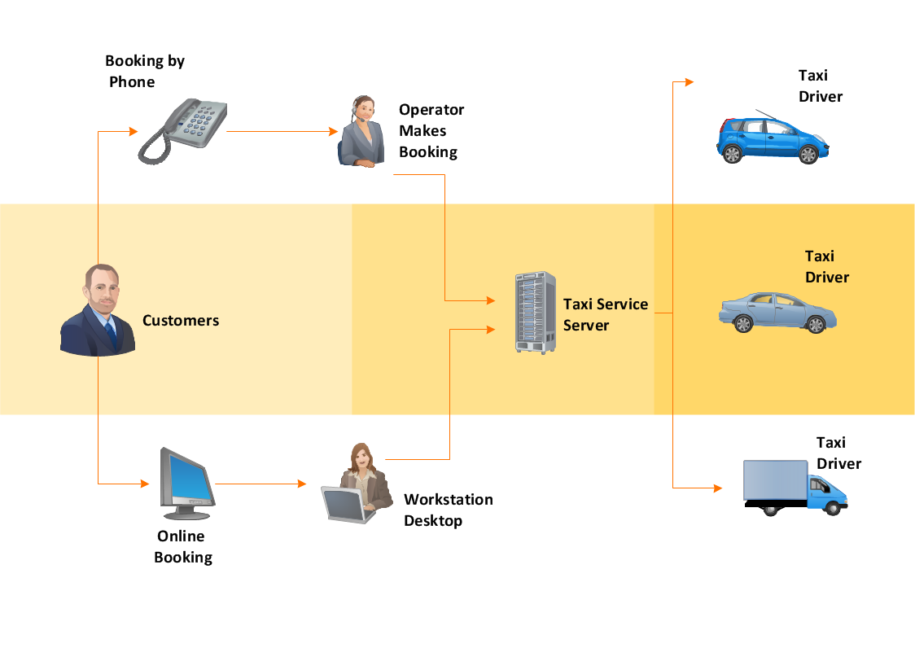
Flow:

Slide 21
Is UML a Language?
UML can be described as a general purpose visual modeling language to visualize, specify, construct and document software system. Although UML is generally used to model software systems but it is not limited within this boundary. It is also used to model non software systems as well like process flow in a manufacturing unit etc.
UML is not a programming language but tools can be used to generate code in various languages using UML diagrams.

Slide 22
Goal of UML
Its goal is to define some general purpose modeling language which all modelers can use and also it needs to be made simple to understand and use.
UML diagrams are not only for developers but also for business users, common people and anybody interested to understand the system. The system can be a software or non software.
Notes:
So it must be clear that UML is not a development method rather it accompanies with processes to make a successful system.

Slide 23
UML Diagrams
UML has many types of diagrams which are divided into two categories. Some types represent structural information, and the rest represent general types of behavior, including a few that represent different aspects of interactions.

Slide 24
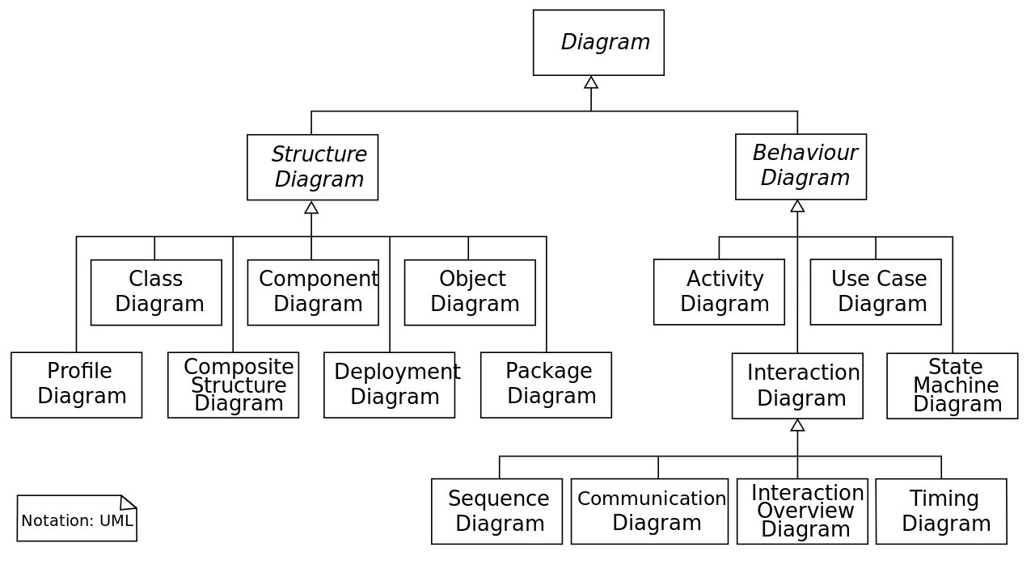
UML Diagram Hierarchy

Slide 25
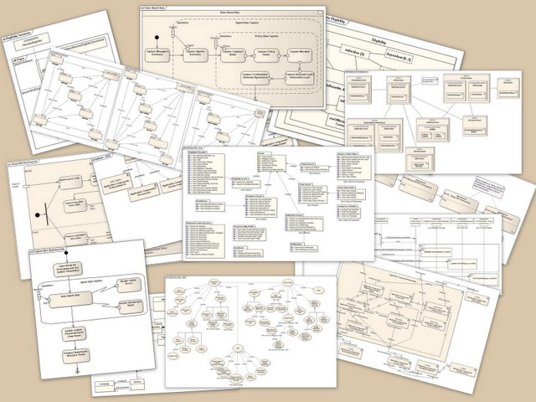

Slide 26
UML Building Blocks
The building blocks of UML can be defined as:
Things
Relationships
Diagrams

Slide 27
UML Building Blocks
Things can be defined as: Structural, Behavioral, Grouping & An-notational.
Relationship shows how elements are associated with each other and this association describes the functionality of an application.
UML diagrams: All the elements, relationships are used to make a complete UML diagram and the diagram represents a system.

Slide 28
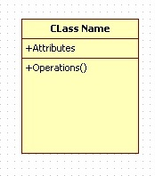
Structural things
The Structural things define the static part of the model. They represent physical and conceptual elements.
Structural things constitutes:
Class: Class represents set of objects having similar responsibilities.

Slide 29
Interface
Interface defines a set of operations which specify the responsibility of a class.
I
Interface

Slide 30
Collaboration:
Collaboration defines interaction between elements.

Slide 31

Use case:
Use case represents a set of actions performed by a system for a specific goal.

Slide 32
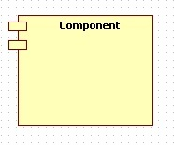
Component
Component describes physical part of a system.

Slide 33
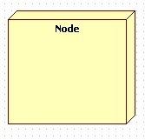
Node
A node can be defined as a physical element that exists at run time.

Slide 34
Behavioral things:
A behavioral thing consists of the dynamic parts of UML models.

Slide 35
Interaction:
Interaction is defined as a behavior that consists of a group of messages exchanged among elements to accomplish a specific task.
Message

Slide 36
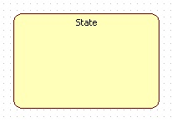
State machine:
State machine is useful when the state of an object in its life cycle is important. It defines the sequence of states an object goes through in response to events. Events are external factors responsible for state change.

Slide 37
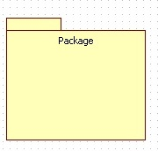
Package:
Package is the only one grouping thing available for gathering structural and behavioral things.

Slide 38
Annotational things:
Annotational things can be defined as a mechanism to capture remarks, descriptions, and comments of UML model elements. Note is the only one Annotational thing available.
Notes

Slide 39
References :
http://www.ibm.com/developerworks/rational/library/6007.html
http://en.wikipedia.org/wiki/Unified_Modeling_Language
http://conferences.embarcadero.com/article/32200
Tutorialspoint.com/ UML Tutorial

Slide 40
Thanks

