Slide 1


Imagine …. you had a way of always finding an effective solution to your health problems and/or help the ones close to you ?
any problem, any time ….
www.quantum-healthcare.com

Slide 2

Imagine again …. that you could have access to this independantly of any social status or financial criteria
any problem, any time, every one, everywhere ….
www.quantum-healthcare.com

Slide 3
Imagine once more …. that you would be able to tap into the world’s biggest pool of know how in regards to global health issues
any problem, any time, every one, everywhere, natural and non-intrusive ….
www.quantum-healthcare.com

Slide 4


Do you want to …. TIZ with us ?
www.quantum-healthcare.com

Slide 5
QUANTUM HEALTH Initiative
Become Actor of your Health
www.quantum-healthcare.com

Slide 6
What is our recipe ?
Tiz and Tizers
1. If we knew what we knew … Use the power of the Community
If you have a health problem, then statistically this problem has already been experienced by hundreds or thousands of other people – across the world. AND SO HAVE THE SOLUTIONS TO YOUR PROBLEM
2. Take control and make it real …. Health will be driven by Users
We are responsible for our health, not the doctor. With our ability to access relevant information via Internet, we can become actve actors of our health, using experts mostly as coaches to help us achieve targeted results
3. Go with the global trends …… Use new and « clean » technologies »
Tomorrow’s health will be sustainable. We need to identify and treat the root causes of problems before they get out of hand. Use natural,
non –invasive means to ensure prevention, less illness and
long-term autonomy

Slide 7
What do we do ?
Simple and practical – solutions for everyday’s User problems
Provide pragmatic and effective solutions to everyone’s health problems NOW and in the FUTURE
Build the N°1 Health User Community to allow direct exchange of knowledge and expertise FAST and USER-driven
Provide a valuable complement to professional actors as to concrete field issues and effective solutions from a USER perspective

Slide 8
How does it work ?
The Global Tizer Community
Register as a member of the Tizer community (free of charge)
Describe the health issue or target – post a request
------------------------------------------------------------------------------------------------------------------------------------------------------------------------------------
------------------------------
find a solution
Describe the solution for a health issue or target – post a recipe
------------------------------------------------------------------------------------------------
live update by users
discuss with
other users
Global Health Book
the universal library of health solutions from a (personal or professional) user perspective
live update
by users
live user exchange
propose a
solution
Describe a health technology, therapy, product or service - propose a solution
View of the most frequent user health problems
- per region and type of user issue
launch a project
live update by users
Global Health Shop
the webshop

Slide 9
What can YOU do ?
The active Tizer in the Community
As a member of the User Community you can (amongst other things)
define and post a request for health assistance (find a solution to your problem or target)
identify a solution to your problem/target in the Global Health Book
contact and exchange with other members of the User Community to discuss issues and possible solutions
propose a solution to a general or specific health problem or target
launch a Community project to identify and/or develop a solution to a specific or common health issue (e.g. for a common field issue, or for a single case)
propose a technology, product, therapy, service that you are able to provide
act as an ambassador for a region or topic (e.g. identifying health issues or solutions)
become an entrepreneur in the Global Health sector by launching
your service or product business in one of the Community fields
of interest

Slide 10
What reference system do we use ?
The QH frame – an on-going user reference system
Our scientific community has developed a global reference system called QH (Quantum Health) frame work. This new system is like the latest generation TGV (french rapid train), taking into account the experiences of the old systems but integrating all most recent findings in the fields of biphysics, space and space health research, and complementary therapies and products, all based on the principles of natural and non-intrusive means.
The following paragraphs provide an outline of the structure of this new reference frame work. We propose to use best practices from a variety of industries in terms of skills and reference system development – meaning that we will continuously work with the entire Community to enrichen and adapt the reference frame work to make it ever more comprehensive, tending towards « perfection » but never totally complete as there will always be new
Discoveries and/or user needs requiring constant adapation of
the « living manual ».

Slide 11
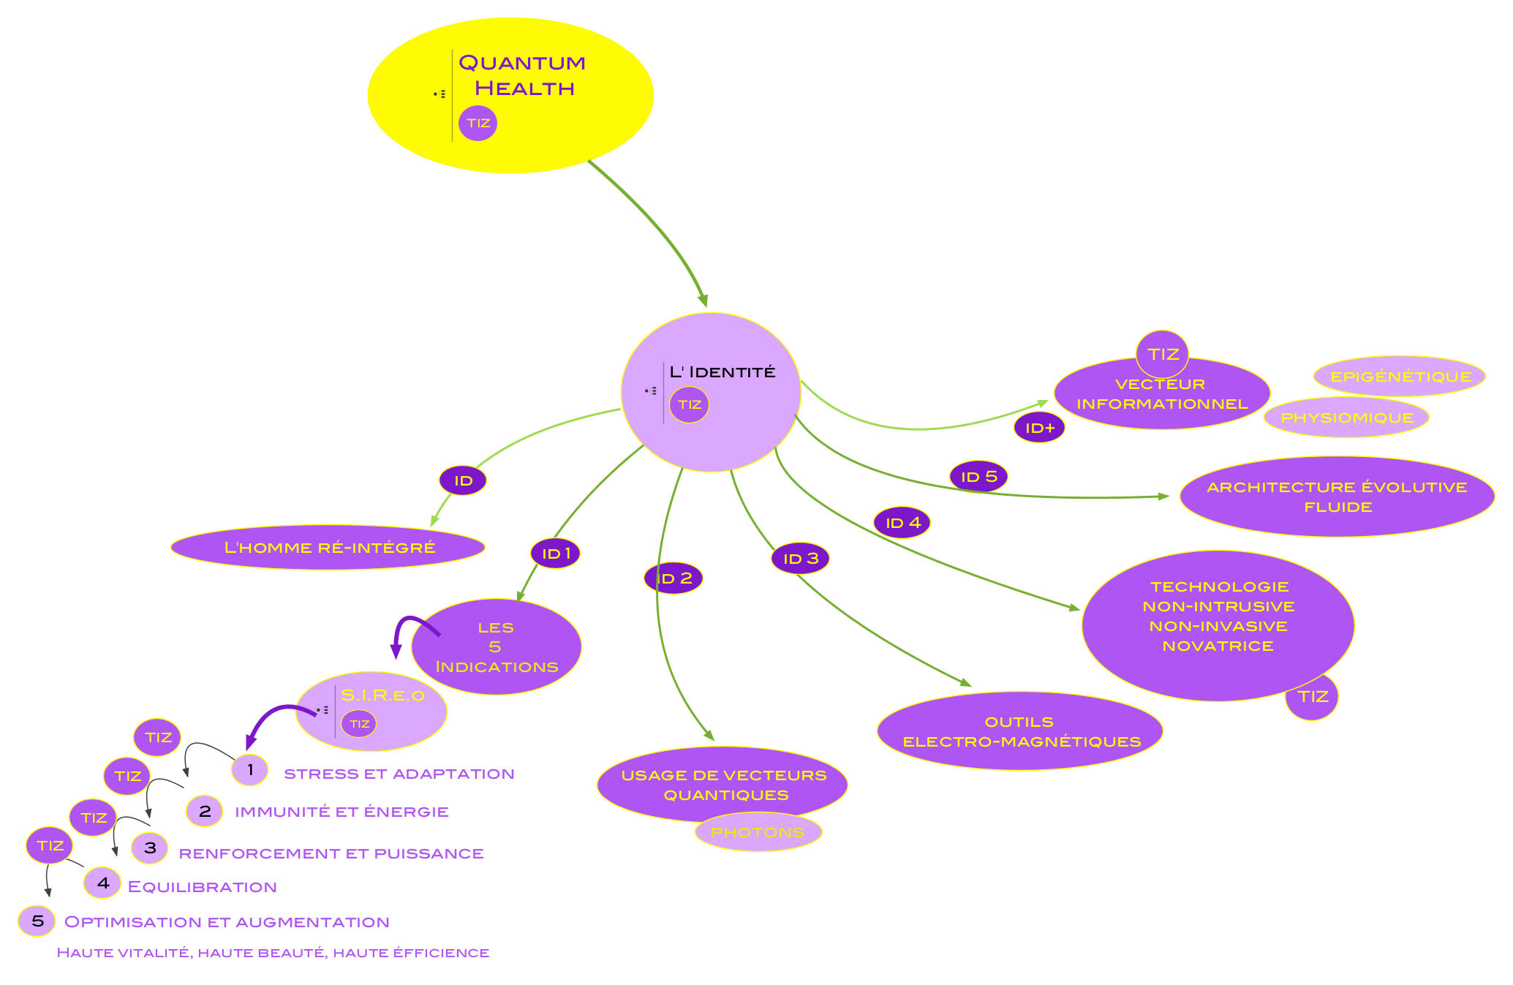
The QH reference system
Transversal Informational Health – the TIZ basis

Slide 12
How does it work ?
The Global Tizer Community
Register as a member of the community (free of charge)
Describe the health issue or target – post a request
------------------------------------------------------------------------------------------------------------------------------------------------------------------------------------
------------------------------
Describe the solution for a health issue or target – post a recipe
------------------------------------------------------------------------------------------------
Global Health Book
the universal library of health solutions from a (personal or professional) user perspective
Describe a health technology, therapy, product or service - propose a solution
View of the most frequent user health problems
- per region and type of user issue
Global Health Shop
the webshop

Slide 13
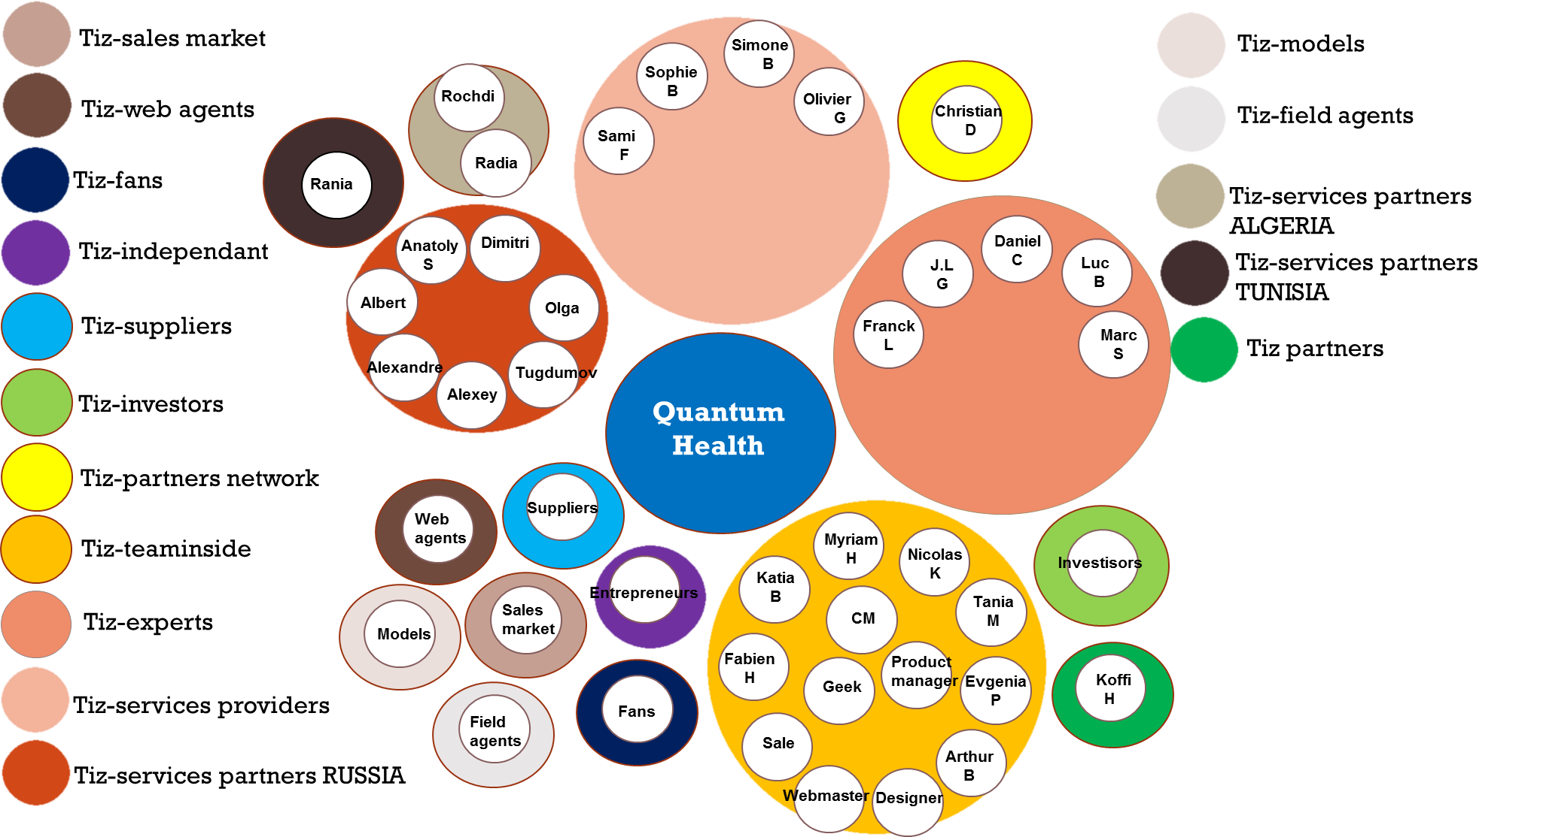
Who are we ?
The Core-Tizer Community

Slide 14
The TIZER language
TIZ vocabulary and glossary (extract)
TIZ = transmitter of information in zintracellular mode
Tizer = member of the TIZER community, constantly shares information about global health issues and solutions
Exper-Tizer = member of the TIZER community recognized for a specific expertise
Co-Tizer = member of the active Tizer team, contributes to the development and animation of the Community
Qvacks = visual or oral contribution (video clip, song, ..)
Qvackser = member of the TIZER community who produces Qvacks
Global Health = a combination of 12 main criteria responsible (more than others) for health longevity and autonomy
Quantum Health = the combined use of innovative space technologies, new health sciences and aligned complementary therapies for effective
diagnostics and treatment

Slide 15
QUANTUM HEALTH Initiative
Become Actor of your Health
www.quantum-healthcare.com

Slide 16
QUANTUM HEALTH Initiative
A Global Health User Community – matching problems with solutions
An affordable access for All – to natural, non-invasive Global Health
An effective solution - for 80% of Global Health problems across the world

Slide 17
The « scientific » part
Overview

Slide 18
Where it comes from
A coming together of several streams of knowledge
Space health research (originally initiated in Russian space programs in the early 1970’s) and simultaneous discoveries in global astrophysics and cosmic physiology (Europe, USA) which led to related developments of technologies for investigation and therapy of cosmonauts.
A new dimension of physiology (Integrative Physiomics) which allows to envision a pathology under a different attitude, and to put it into a direct relationship with all other functions enabling us to understand the sense and cause of an illness or of a health disturbance.
A systematic review and structuration of numerous old energy-based medicines and therapies now organized under the new reference system of Integrative Medicine with a common trunk of investigation means and four branches of therapies.

Slide 19
What benefits it provides
Innovation and inherent breakthrough (Kaikazu)
Global Health Access and Improvement
Easy and Affordable access to Global Health for all
Effective Anticipation and Prevention
Effective Treatment of approx. 80% of Global Health issues
Education and Autonomy Development of Health Users (Patients)
Global Health Total Cost Optimization
Non-intrusive technologies, natural therapies and products Prevention versus Cure, Root Cause Treatment versus Symptom suppression
5 times less costly, 5 times more effective – for ~ 80% of Global Health Issues
Optimization of TCH (Total Cost of Health) in Integrative Medicine Approach (in combination with effective conventional Medicine)
Global Health Business Development
- Excellent return for economic actors in all related areas (20-30%)
Significant growth potential for direct and adjacent business development
Development of new skills and jobs across health-related professions
Image and visibility for increased attraction of interest and people

Slide 20

Comparative benefits
Conventional medicine is effective in cases of emergency (e.g. need for surgery) or in acute illnesses – these cases represent approx. 20% of all global health problems. Quantum Health is effective in the upfront detection and prevention of possible illnesses, in root cause diagnostics and in treatment of all health cases outside of emergency and highly acute issues. These cases represent the remaining 80% of all global health issues. Quantum Health does not replace conventional medicine, but effectively completes it. We provide a significant advantage in
Identifying the root causes of current and future health issues, and modifying
the related frame conditions
Initiating and accelerating the healing process via global and local therapies
Recovering from current health issues and improving global health
Measuring concrete effects of treatments (Quantum Health + Conventional)
Preventing health issues to occur and/or to get out of control
Increasing health autonomy and decreasing dependency on intrusive therapies and/or biochemical drugs
Allowing to live better and more autonomously
30+ years of research
20+ years of practice

Slide 21
QH Reference System - overview

Slide 22
How it works – Sample Protocol
Introduction to Global Health Vision and Quantum Therapy
Investigation of Patient’s Global Health (360° Investigation on 12 main criteria for life expectancy and longevity)
Quantum Health “AS IS” and “AS WILL” - Investigation and Root Cause Diagnosis
Informational Quantum Therapy Level I (Global and specific informational treatment of relevant functions of the body in regards to root causes and existing/upcoming health issues)
Energy-focused Quantum Therapy Level II (Local and specific treatment of relevant functions and areas of the body)
Complementary therapy or therapies as required according to the results of the diagnosis and the recommended treatment by the Quantum Health Team (e.g. Aroma-therapy for functional and/or emotional disorder)
Prescription of natural elements (trace elements, minerals, nutritional complements, aroma-therapy components and/or other relevant components for specific Quantum Health therapies)
Individual Debriefing and instructions for individual and monitored follow up

Slide 23
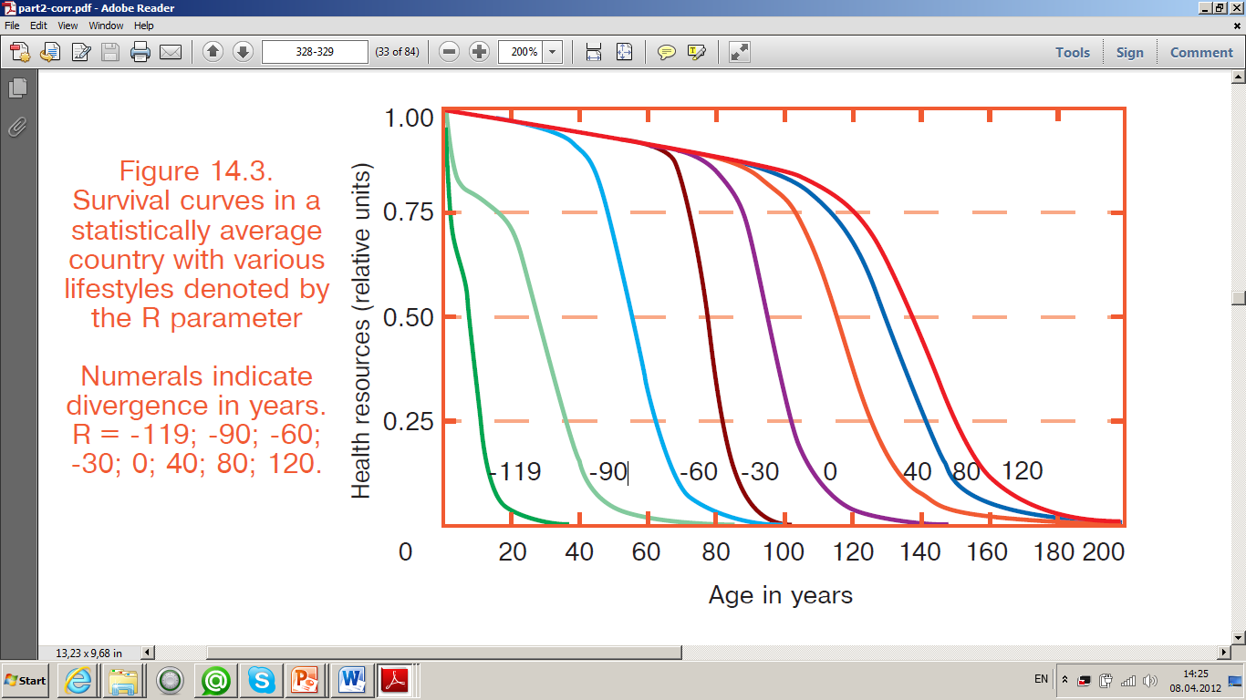
Global Health and Longevity
depends on use of personal and public resources
Personal resources
Quality of food
Water consumption
Breathing
Movement
Sanitary conditions
Mental condition
Public resources
Quality of education
Social habits
Medical service
Heredity
Working conditions
Environmental condition
Our 27-year statistical studies show that the average marginal life expectancy of the human population is 144 years.
The current generation uses only 30% of the potential of the resources granted to us.

Slide 24
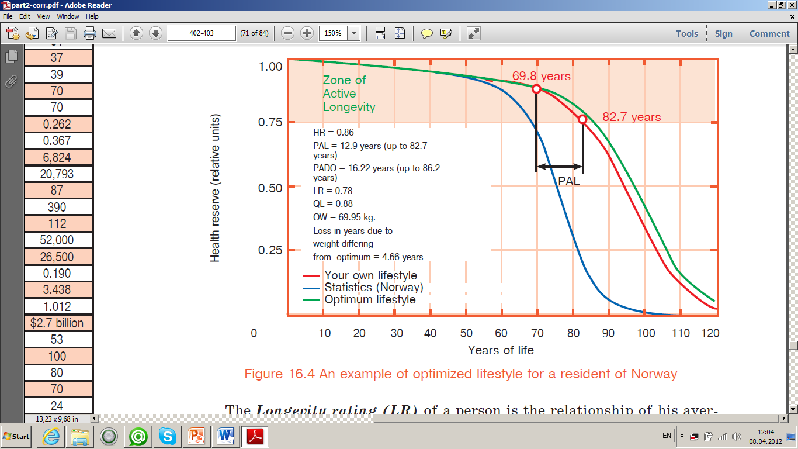
Global Health – user case
Level of business activity and Life Span
The patient is on the bottom border of a zone of active longevity (see a blue curve). The age is indicated by a blue point.
The most critical parameters of a resource are chosen
The recommended lifestyle is calculated(see a red curve).
Forthcoming period of active longevity: 12,9 years
Expected life expectancy: 95,8 years
Rating of longevity (0-1): 0,76
Optimum weight: 69,95 kg
Losses of years because of overweight: 4,66 years
Quality of life (0-1): 0,88
The optimum curve of life is calculated (see a green curve).
ADDED HEALTH RESOURCE
HOW MANY YEARS +

Slide 25
How we will develop it
Quantum Health
Reference Board
- Doctors
- Therapeuts/Practitioners
- Users/User Representatives
Quantum Health (QH)
QM Reference System
QH Congresses & R&D
1
Coordination of Research
Congresses & Conferences
Publications
Congress I
R&D teams
Congress II
R&D teams
Congress III
2
QH Academy
3
QH Centers
4
QH Institute
M
1
Medical Prevention & Therapy
Quantum Treat Center
Root-Cause Diagnostics | Nutri-Therapies | Dynamo- Therapies | Osmo- Therapies | Relatio- Therapies
Genetics/ Epigenetics | Oligo/Litho | Massages | Balneo/Fango | Sophrology
Mineralomics | Phyto/Gemmo | Osteopathy | Creno/Thalasso | Meditation
Proteomics | Aroma | Odontology | Olfacto | Relaxation
Physiomics/Scan | Vitamino | Chiropractics | Homeopathy | Aromacology
Pulsology/ Cardiometry | Diets | Reflexo | Bioresonance | Positive Psychology
Medical Imaging | Food regimes | Kinesiology | Ionization | Phosphenism
Reflexology | Fasting | Electro | Ozono | Bioenergy
Bioelectronics | Phago | Magneto | Actino/Chromo | Art
Thesigraphy | Biotics | Exos | Milta/Quantum | Method Vittoz
Typages | Spagyrie | Acupuncture | Cristallo | Gestalt
Users
Doctors
Therapeuts
2
Beauty & Well-Being
Quantum Care Center
Certified & Open Training
for
Health Users
Therapeuts
Paramedical Staff
New/Future Doctors
Existing Doctors
including
Product/Tool Training
Business Modeling for future Practitioners
Program design & delivery
Validation of programs & schools/institutes
3
Performance & Dynamics
Quantum Power Center
1. Stand-alone
Any size, standard or upscale architecture
2. Integrated
Luxury/Health Resorts, Sports Parks, Theme Malls/Villages
3. Customized
Oil/Gaz platforms, Specific treatments, Prevention centers
4. Mobile Operations
Individual Treatments for wealthy families, Field campaigns
Sourcing & Selection of Technologies & Equipment, Products & Services in the QM Reference System
Testing and validation by a team of QH Experts & Doctors
Distribution to health professionnals and health users
Use of the QH Distribution platform and/or regional partners

