Slide 1
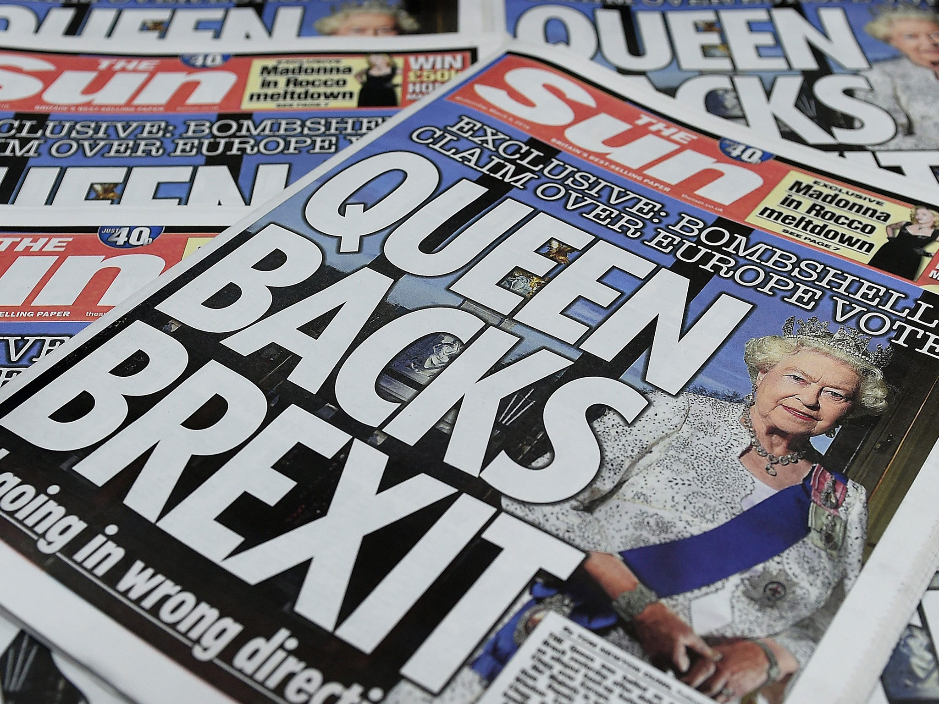

Slide 2
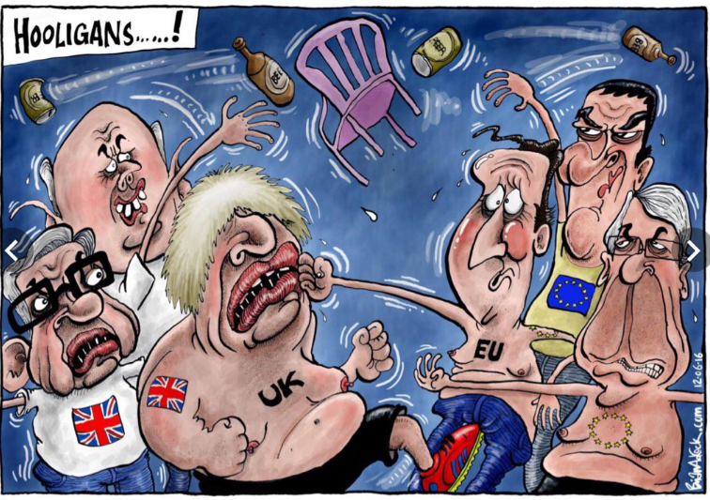

Slide 3
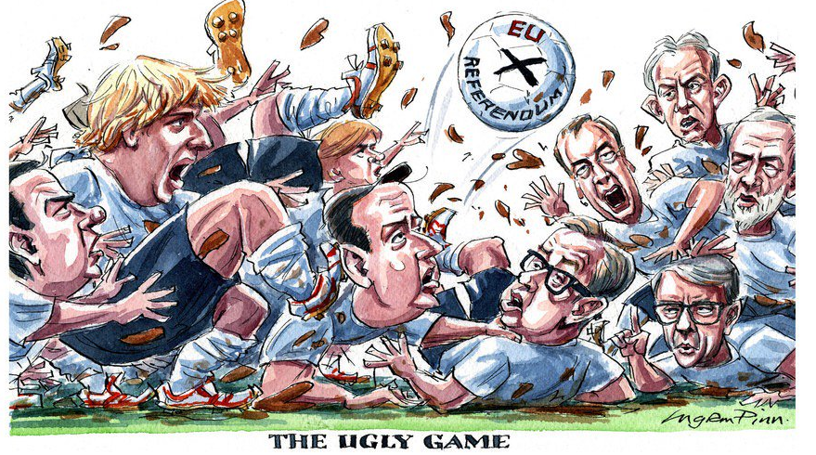

Slide 4

bit.ly/brexitemn

Slide 5
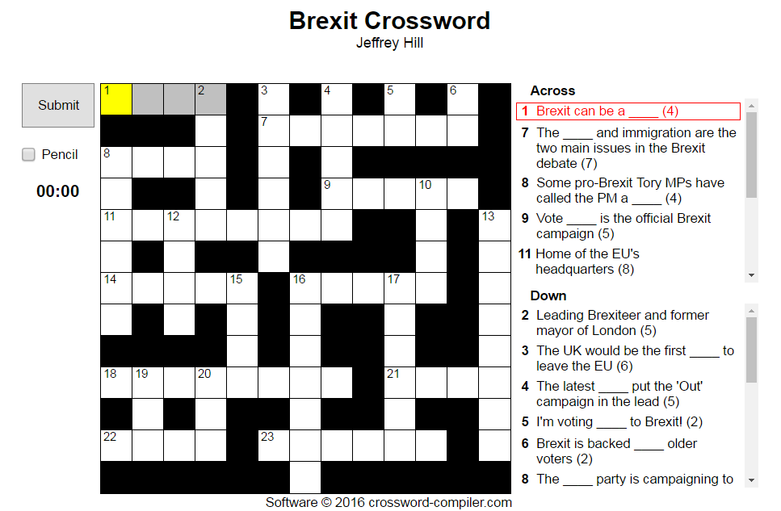
bit.ly/brexitemn2

Slide 6
EU Referendum Debate
Should the United Kingdom remain a member of the European Union or leave the European Union?

