Slide 1
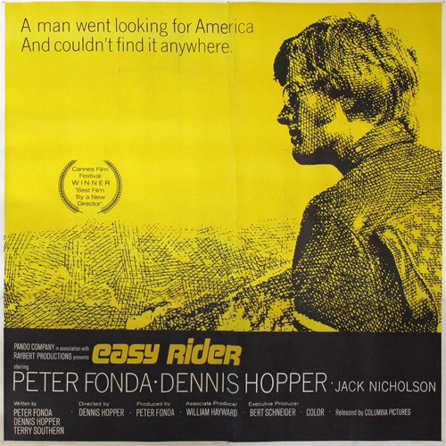

Slide 2
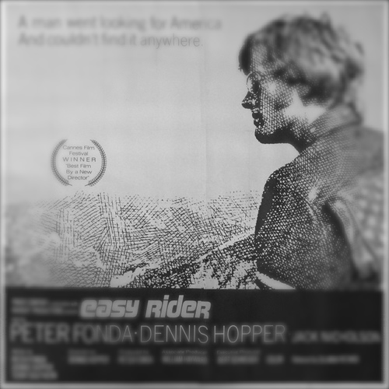
EASY RIDER REVIEW
GENERAL INFORMATION
GENRE
MAIN CHARACTERS
PLOT
INTERPRETATION

Slide 3
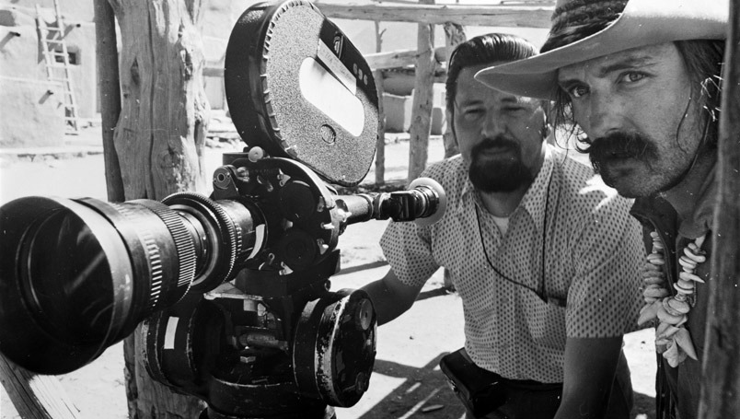
GENERAL INFORMATION
Director - DENNIS HOPPER
Written by Peter Fonda, Dennis Hopper & Terry Southern
Producer - Peter Fonda
Release date - 1969 - Rated R
Main actors - Dennis Hopper – Peter Fonda – Jack Nicholson
Film's original title - The Loners.
Cost - 400,000$ vs Profits 60,000,000$ worldwide

Slide 4
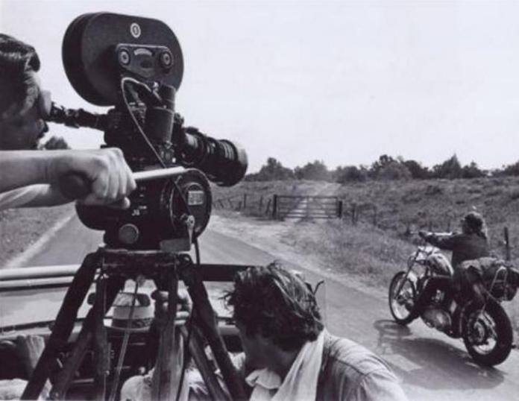
Genre - Genres ?
Motorcycle movie
Tragedy
Western movie
Road movie
Artistic or Experimental movie

Slide 5
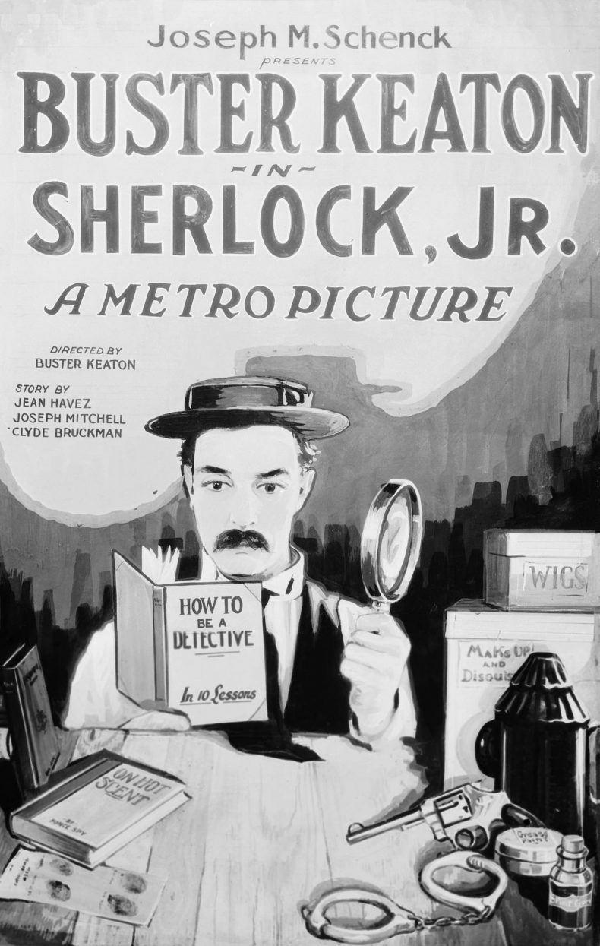
Sherlock Junior - 1924

Slide 6
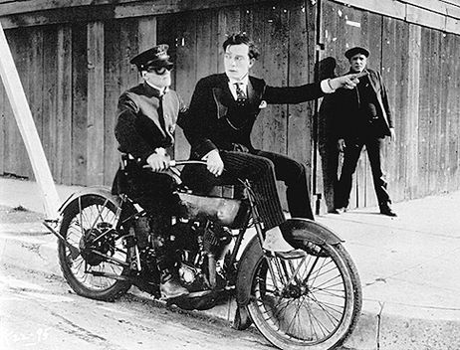
Sherlock Junior - 1924

Slide 7
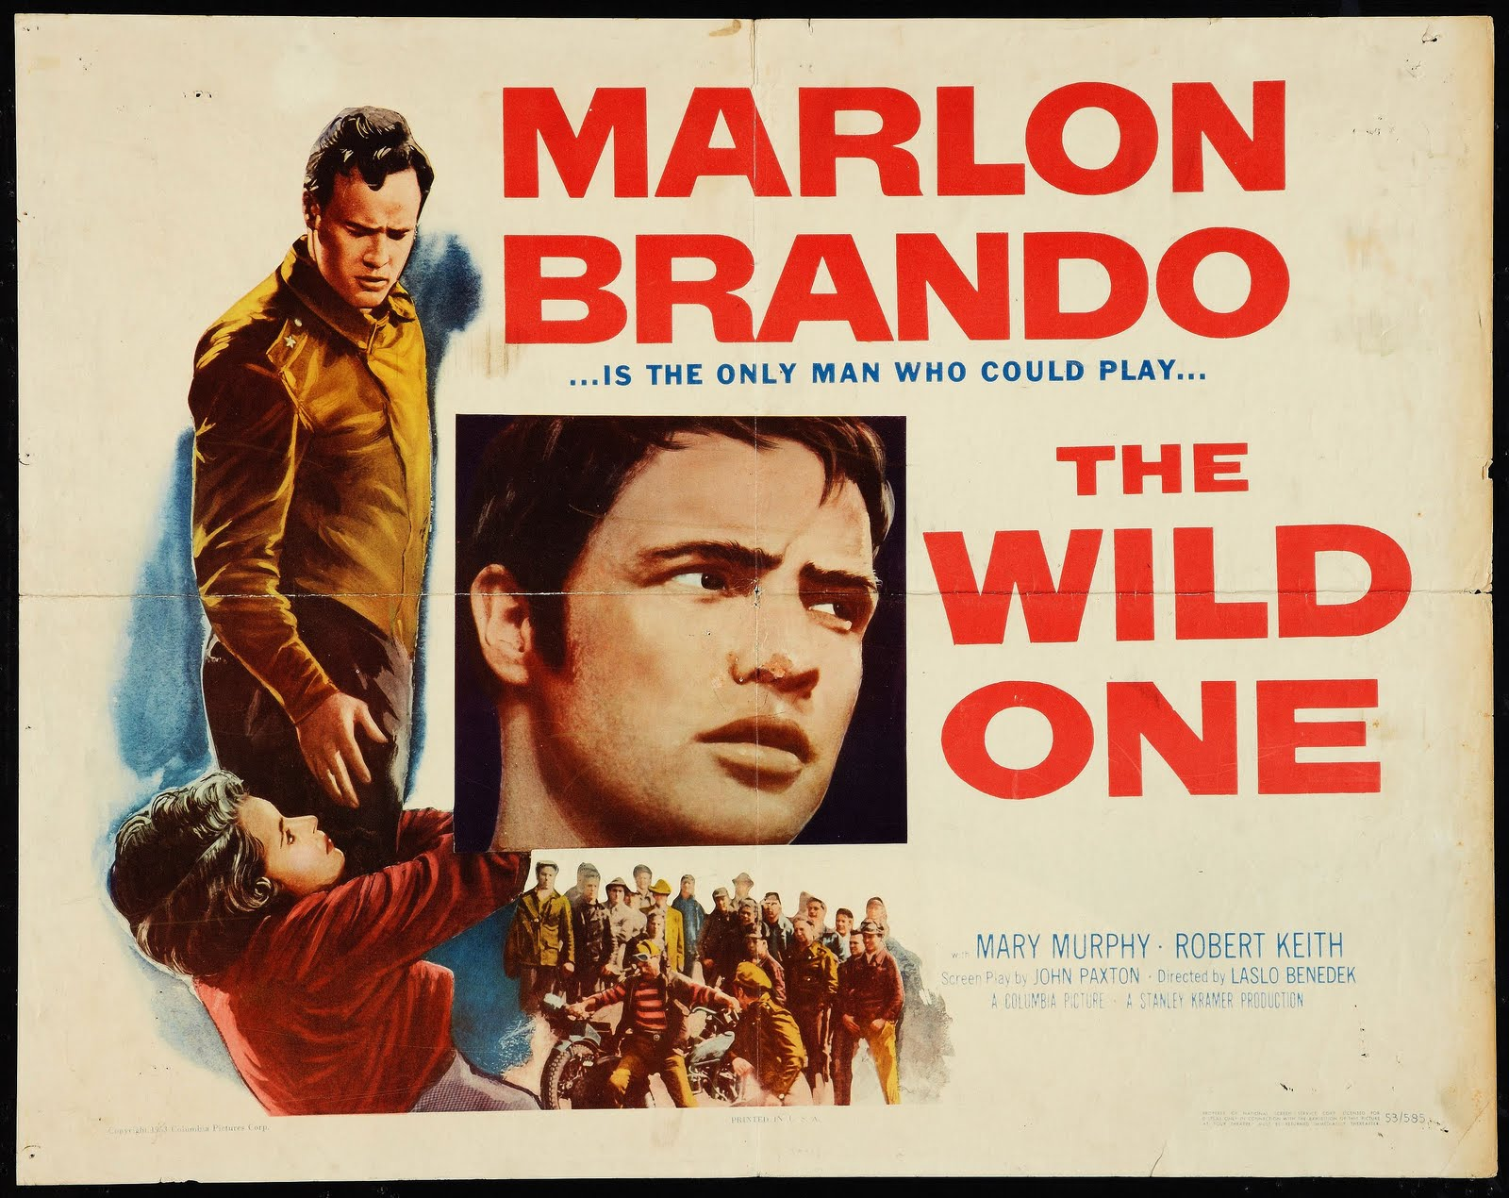
The Wild One - 1953

Slide 8
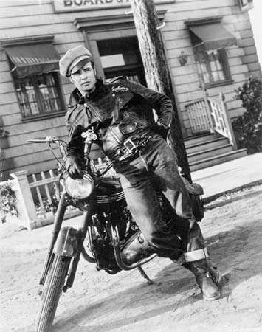
The Wild One - 1953

Slide 9
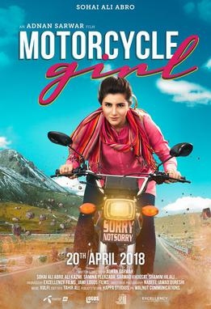
Motorcycle Girl - 2018

Slide 10
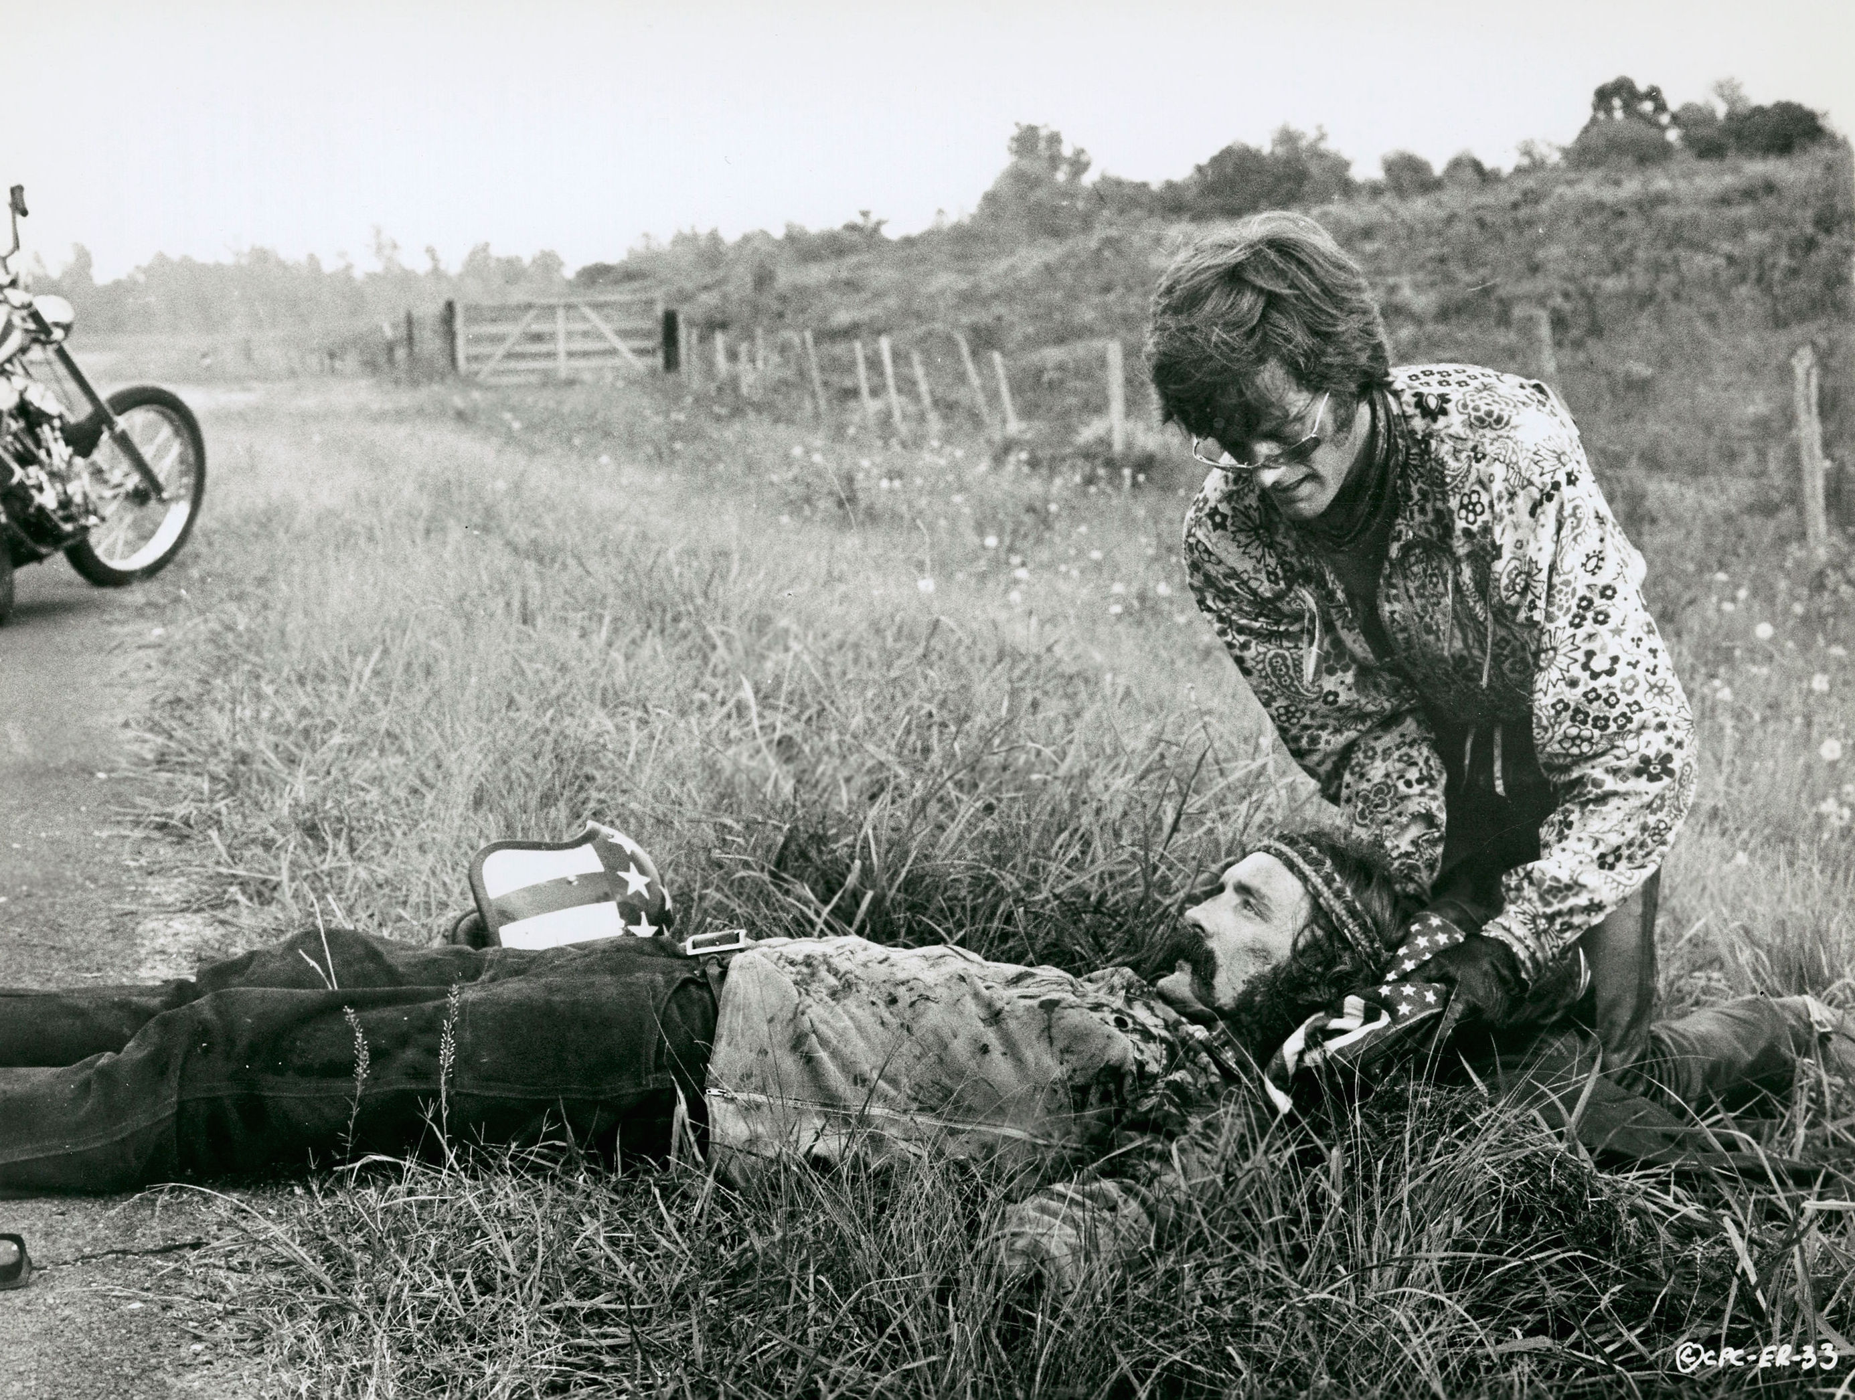
Tragedy
A narrative work that portrays or depicts calamitous events and has an unhappy but meaningful ending

Slide 11
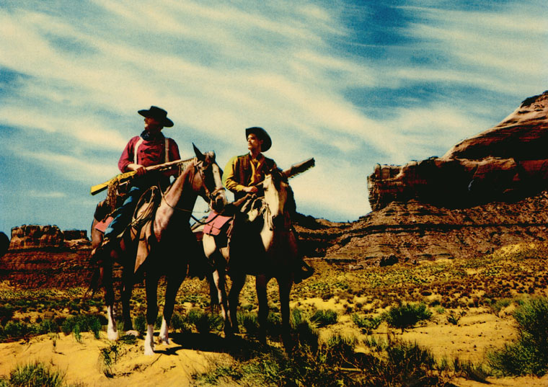
Western movie
A dramatic work including themes, characters, or settings characteristic of the American West, especially during the era of exploration and early development, late 1800s.

Slide 12
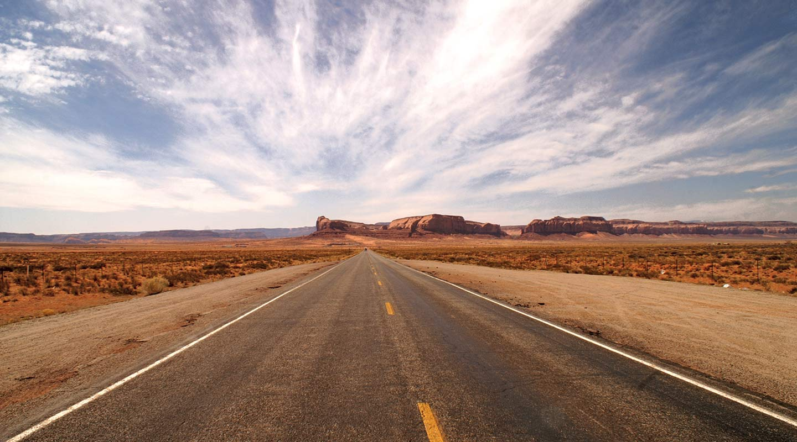
Road movie
On The Road (novel)– Jack Kerouac – The Beat Generation
movie of a genre in which the main character is traveling on a journey of self-discovery.

Slide 13
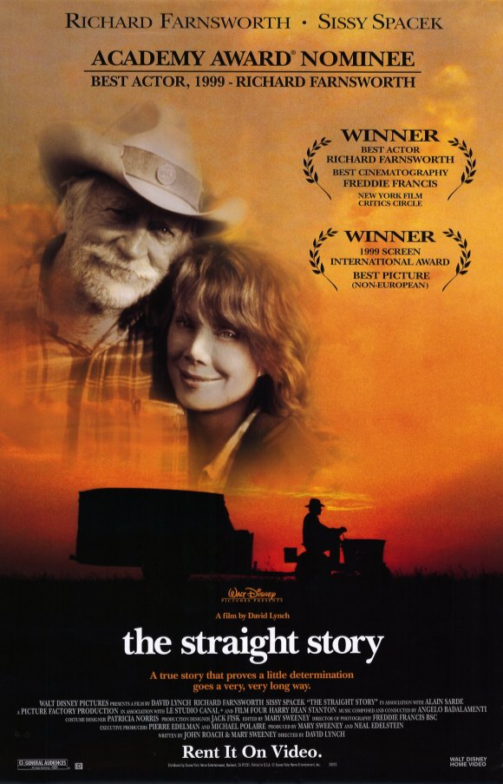
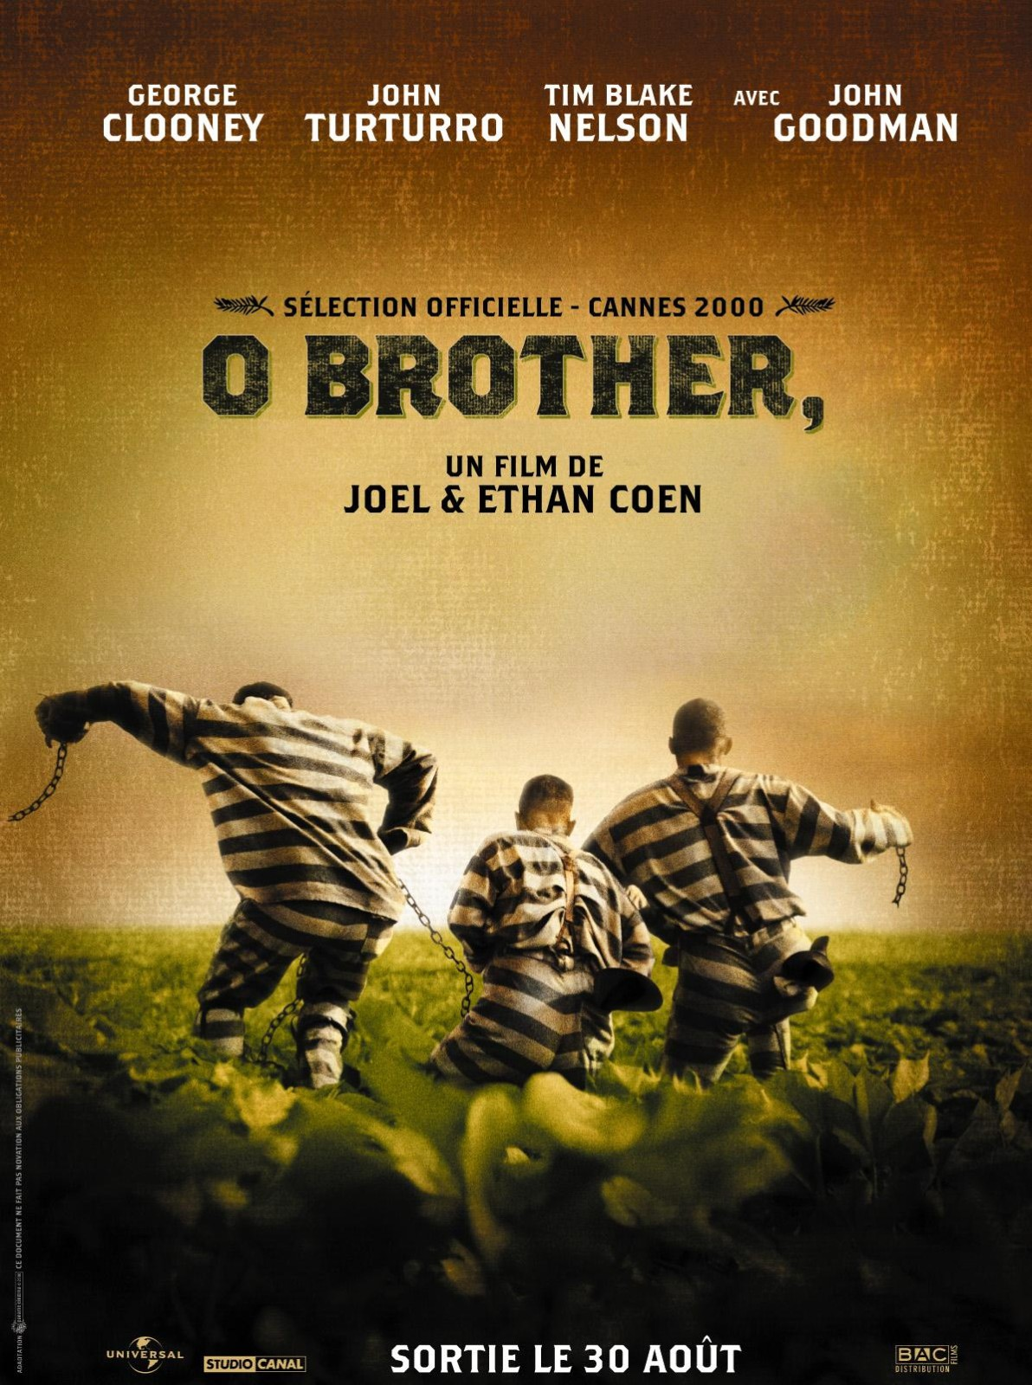
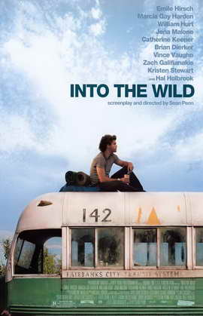
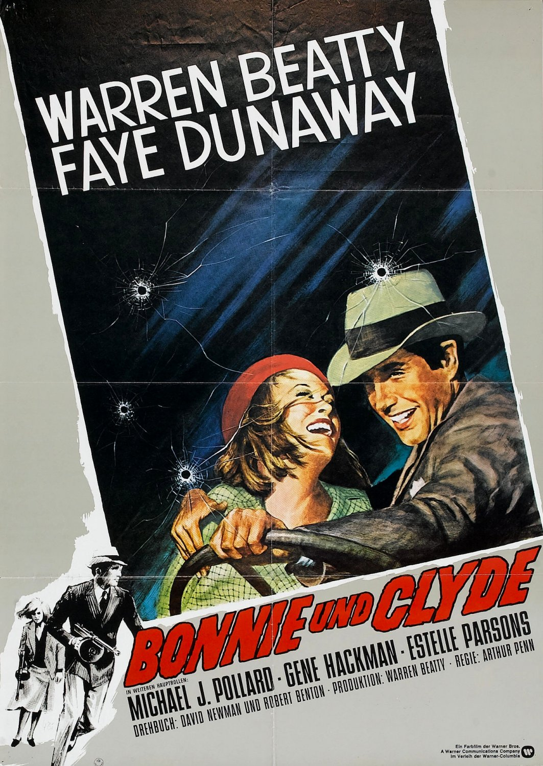
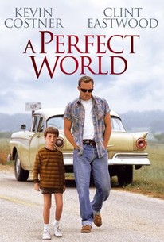
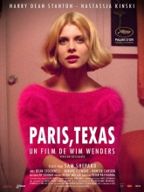

Slide 14
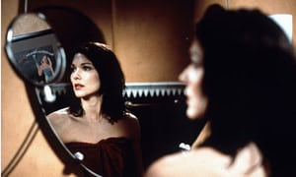
Art house or Experimental Movie?
Low Budget
First Movie
Montage
Scenery
Photography
Minimalism: dialogues - plot - characters
Cycles and loops

Slide 15
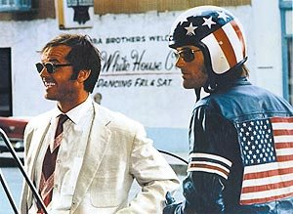
CHARACTERS

Slide 16
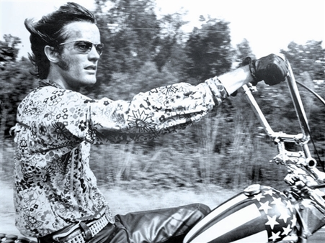
“Captain America”
Wyatt (Earp?)
National emblem
Introspective and calm
Understanding and patient
Cunning but trustworthy
Premonitory: “We blew it”

Slide 17
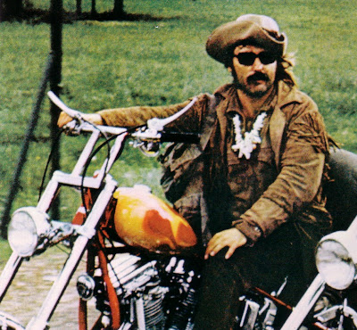
BILLY
Billy the Kid
Mustached and shaggy, long-haired, with a tan-colored bush hat, fringed buckskin jacket, shades, and an Indian necklace of animals' teeth
Post hippy punk
“that's gonna be the weirdest trip, you know”

Slide 18
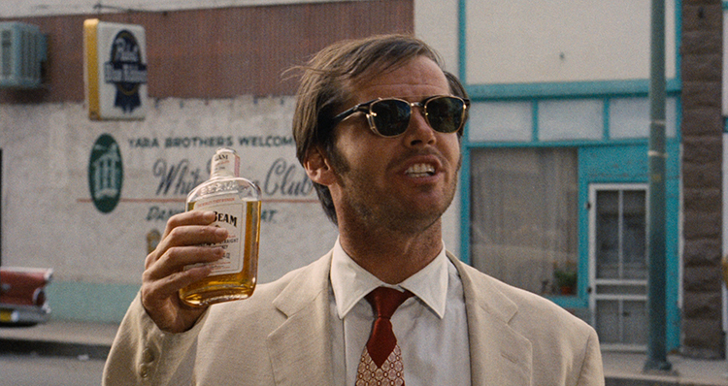
GEORGE HANSON
Combination of liberal and conservative ideals
Binge drinker, frequent visitor to local jail
Educated
ACLU lawyer (American Civil Liberties Union.)
“They're not scared of you. They're scared of what you represent to 'em.”

Slide 19
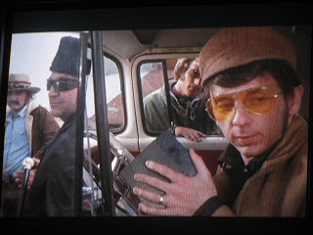
Phil Spector
Produced the album ‘Let it Be’, by the famous Beatles

Slide 20
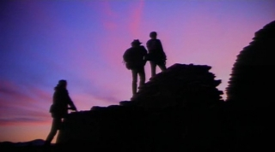
PLOT
After getting illegal financing in Mexico, Captain America & Billy buy new motorcycles and head from L.A to New Orleans to attend Mardi Gras celebrations (via New Mexico, Las Vegas)
On the way they encounter different American characters of the end of the 1960s
the two charcters fail to retire in Florida as they are eventually murdered

Slide 21
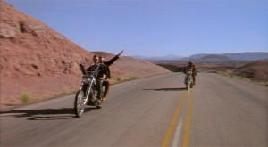
INTERPRETATION A desillusioned America
Law & Outlaw
Rejection & Rednecks
Hippy reality
Women & Religion
Psychoactive substances
Civil rights

Slide 22
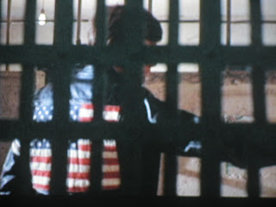
Law & Outlaw
George, ambivalent lawyer
Police forces = the law
Corruption – lynching
Smuggling

Slide 23
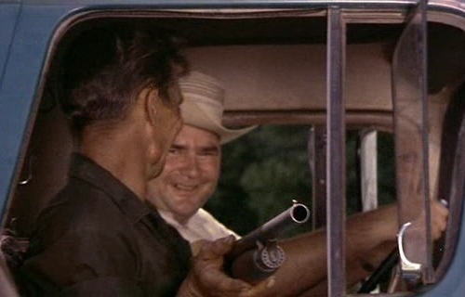
Rejection & Rednecks
George Hanson: ‘They got this here, see, scissor-happy, beautify America thing going on around here. They're tryin' to make everybody look like Yul Brynner. They use rusty razor blades on the last two long hairs that they brought in here and I wasn't here to protect 'em’
No vacancies
No food either
No money (except in the opening scene)
No cheap cure for the cancerous shooter

Slide 24
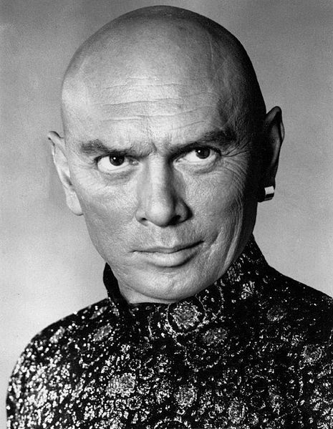
Yul Brynner

Slide 25
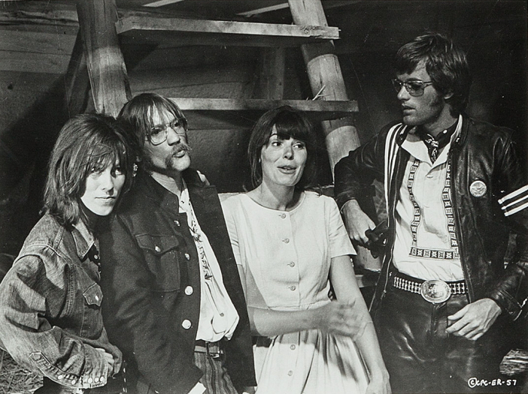
Hippy reality
Contradictory values
Leadership question
Protectionism
Idealism vs pragmatism
Captain America: You get much rain here, man?
Stranger on the Highway: I guess we're gonna have to dance for that.

Slide 26
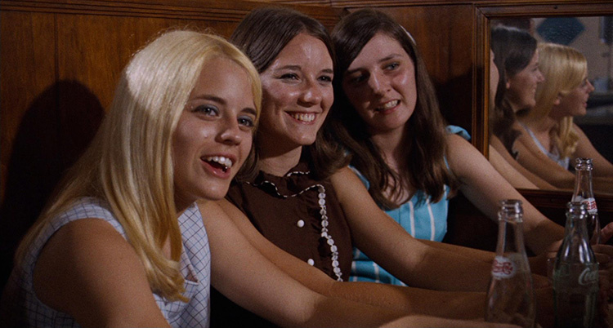
Women & Religion
George Hanson: ‘I mean, it's real hard to be free when you are bought and sold in the marketplace.’
Underrepresented
Stereotypes
Mary and the graveyard scene
Captain America : ‘If god did not exist it would be necessary to invent him.’

Slide 27
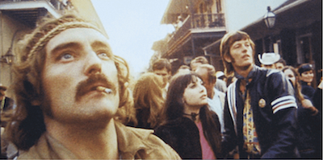
Psychoactive substances
Steppenwolf's "The Pusher," a song which is overtly against hard-drug pushers and dealing.
‘You know I smoked a lot of grass Oh Lord, I popped a lot of pills But I've never touched nothin' That my spirit could kill You know I've seen a lot of people walkin' round With tombstones in their eyes But the pusher don't care Aw, if you live or if you die God damn the Pusher’
‘Fear and loathing in Las Vegas’

Slide 28
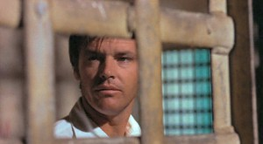
CIVIL RIGHTS
George = ACLU lawyer
Billy: Listen, do you think you can help us get outta here with no sweat?
George Hanson: ‘Well, I imagine that I can if you haven't killed anybody - at least, nobody white.’

Slide 29


Slide 30
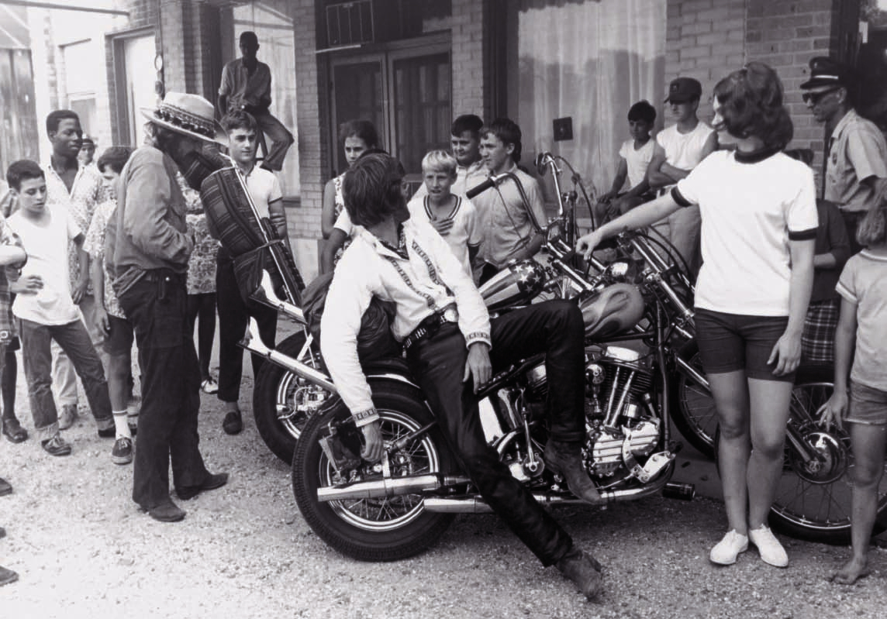
SOUNDTRACK
1. The Pusher Steppenwolf
2. Born To Be Wild Steppenwolf
3. The Weight Smith
4. Wasn't Born To Follow The Byrds
5. If You Want To Be A Bird (Bird Song) The Holy Modal Rounders
6. Don't Bogart Me (aka Don't Bogart That Joint) The Fraternity Of Man
7. If 6 Was 9 Jimi Hendrix Experience
8. Kyrie Ellison Mardi Gras The Electric Prunes
9. It's Alright Ma (I'm Only Bleeding) Roger McGuinn
10. Ballad Of Easy Rider Roger McGuinn

