Slide 1
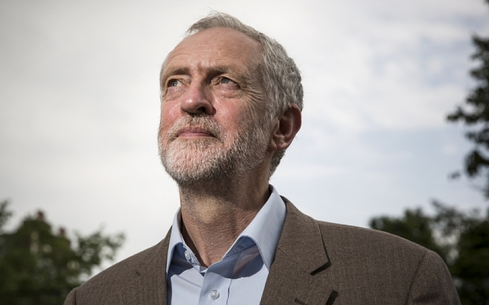
The new political leader of the U.K

Slide 2
Contents
I) The increase in power of an atypical leader
A) Who is Jeremy Bernard Corbyn?
B) The progress of the Labour Party Primary
II) Daring ideas supported by a part of Europe
A) A new vision of the Labour Party according to Corbyn and his influential allies
B) Labour comparison with the Democratic party

Slide 3
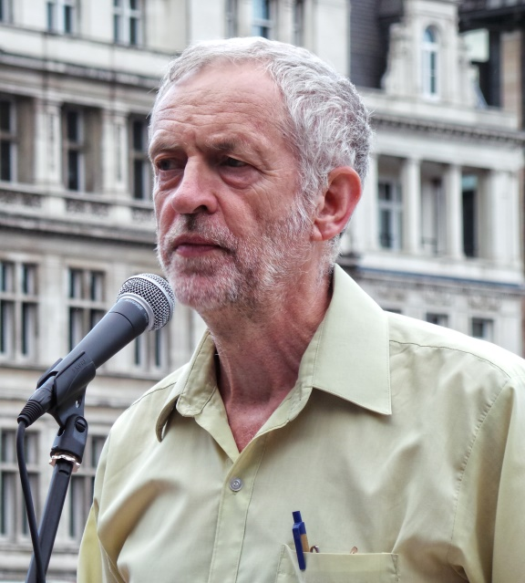
I) The increase in power of an atypical leader
Who is Jeremy Bernard Corbyn?
May 26th 1949 in Wiltshire
A British political leader
Chief of the Labour Party
A fervent opponent to Tony Blair
Deputy of Islington-North
A nutty look
He supports : nuclear disarmament + creation of animal rights

Slide 4

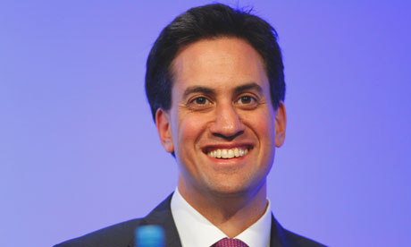
I) The increase in power of an atypical leader
B) The progress of the Labour Party Primary
Defeat of the Labour Party + Resignation of Ed Miliband

Slide 5
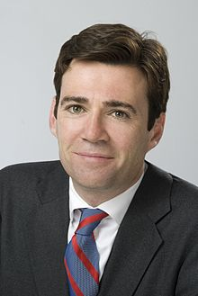
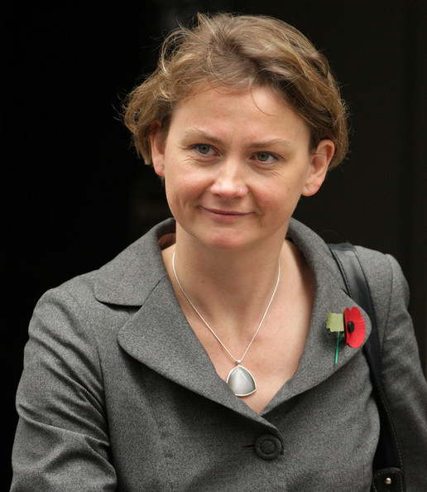

I) The increase in power of an atypical leader
B) The progress of the Labour Party Primary
Serious Candidates: Andy Burnham, Yvette Cooper, Liz Kendall

Slide 6
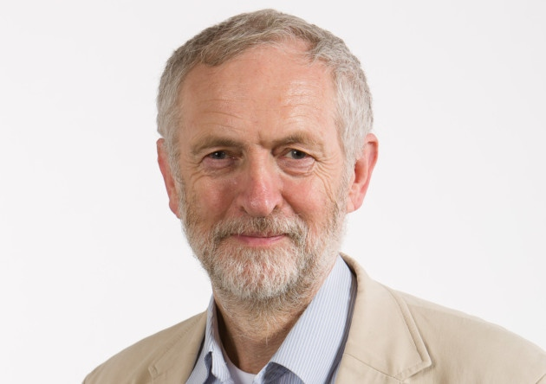
I) The increase in power of an atypical leader
B) The progress of the Labour Party Primary
Jeremy Corbyn Winner 59,5% of votes
Composition of the shadow cabinet

Slide 7
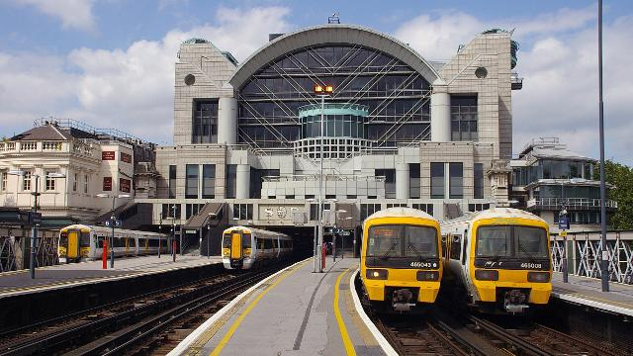
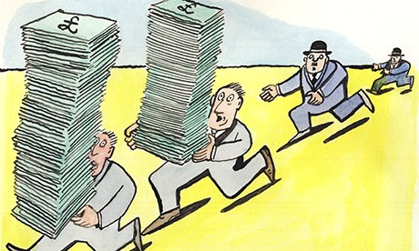
II) Daring ideas supported by a part of Europe
A) A new vision of the Labour Party according to Corbyn…
The re-nationalization of the railway and energy company
The tracking down tax evaders

Slide 8
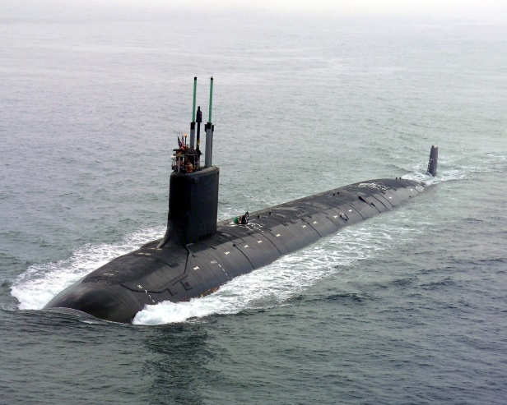

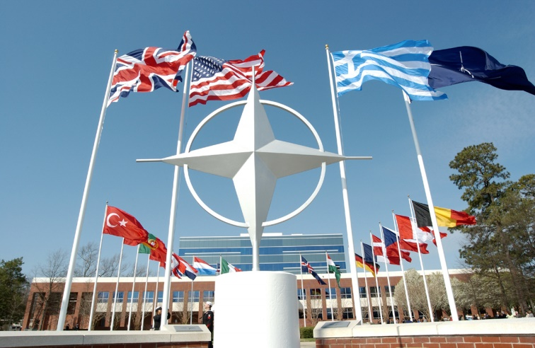
II) Daring ideas supported by a part of Europe
A) A new vision of the Labour Party according to Corbyn…
The exit of the NATO
To wage war on Daech
Increase the taxes for the rich
Decriminalize the cannabis
The disarmament of the British nuclear submarine

Slide 9
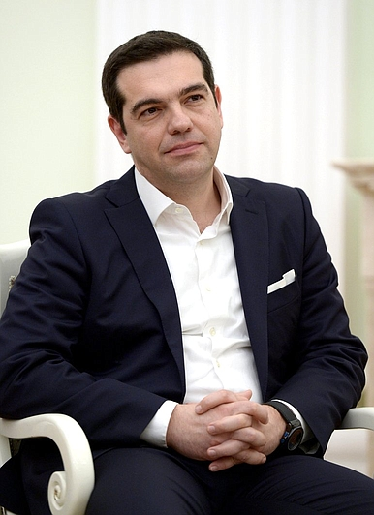
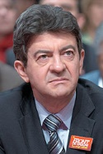

II) Daring ideas supported by a part of Europe
A) …and his influential allies
“SIRIZIA” in Greece
“Front de Gauche” in France
“Podemos” in Spain

Slide 10
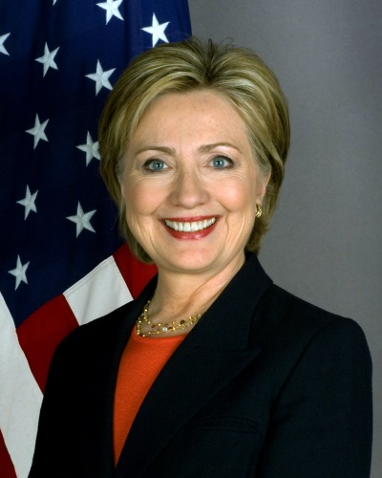
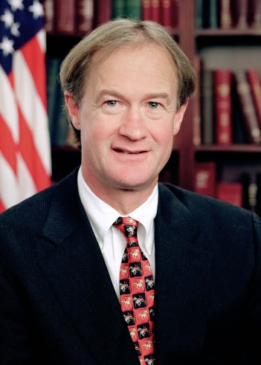

II) Daring ideas supported by a part of Europe
B) Labour comparison with the Democratic party
Hilary Clinton
Reform of the criminal justice
Lincoln Chafee
Republican Party considered like « racist »
Labour Party = equality and nationalization

Slide 11
Sources
http://www.nytimes.com/interactive/2015/06/03/us/elections/lincoln-chafee.html
http://www.usatoday.com/story/news/world/2015/09/29/jeremy-corbyn-keynote-speech/73029662/
https://fr.wikipedia.org/wiki/Jeremy_Corbyn
http://www.nytimes.com/interactive/2016/us/elections/2016-presidential-candidates.html?_r=1
http://www.economist.com/blogs/bagehot/2015/09/labour-party
http://www.theguardian.com/politics/2015/sep/30/tom-watson-corbyn-is-right-choice-for-labour-speech

Slide 12
THE END

