Slide 1
TOEIC Preparation – Photographs
Emma Bowers
ING2
2019/2020

Slide 2
Photographs – 6 questions – 4 minutes
You have 6 photographs to look at in the exam
You will hear 4 possible answers once
Choose the answer that describes what you are seeing
The following slides will help you learn this part of the exam

Slide 3

Actions – he’s tying his shoe laces

Slide 4
The present participle tense is used to describe the action
Accepting
Adding
Bending
Carrying
Cleaning
Driving
studying

Slide 5
Prepositions of movement
ON / off
UP / down
Away / towards
Into / Out of
Get on / get off
Walk into / walk out of

Slide 6

Verbs to describe body Movements

Slide 7
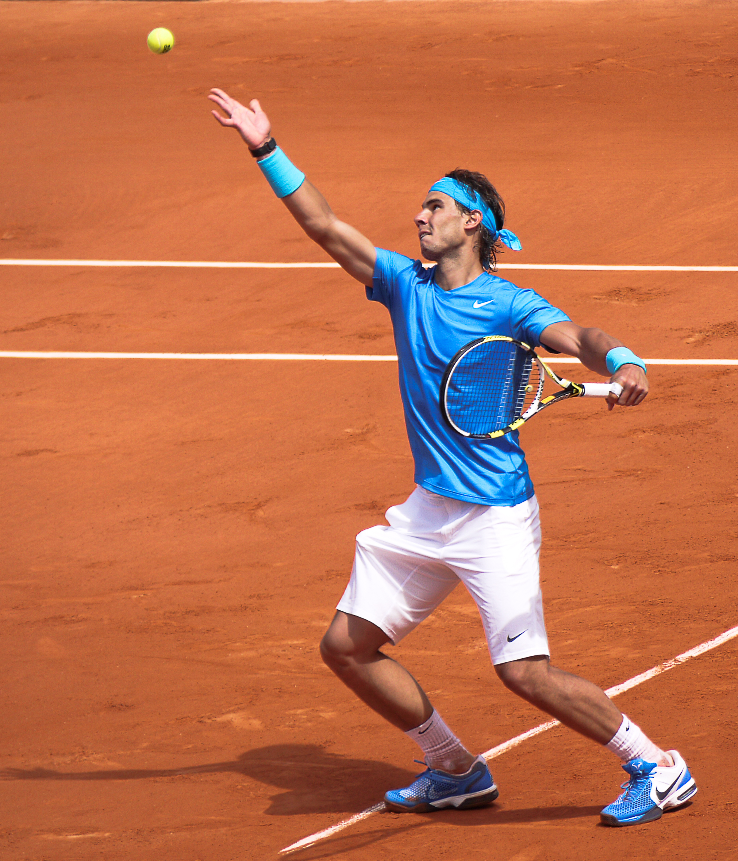


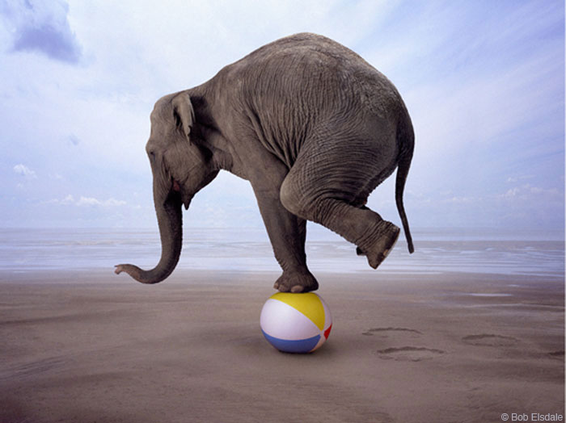
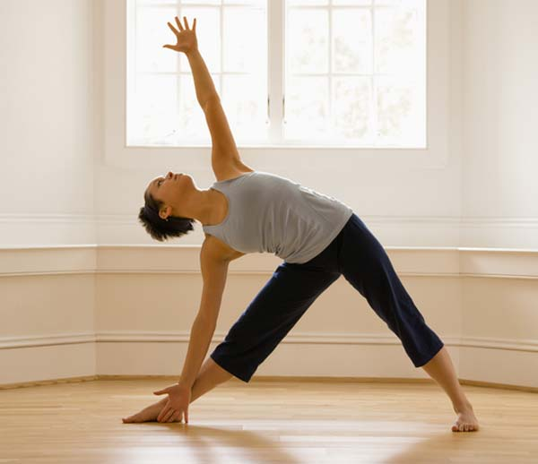


Slide 8
Verbs to describe body movements
Pointing
Balancing
Serving
Stretching
Crouching
watching

Slide 9
Prepositions of place and direction
In / on / at
Above / below
Around / next to
In front of / behind
Opposite / across
By
Inside / outside

Slide 10
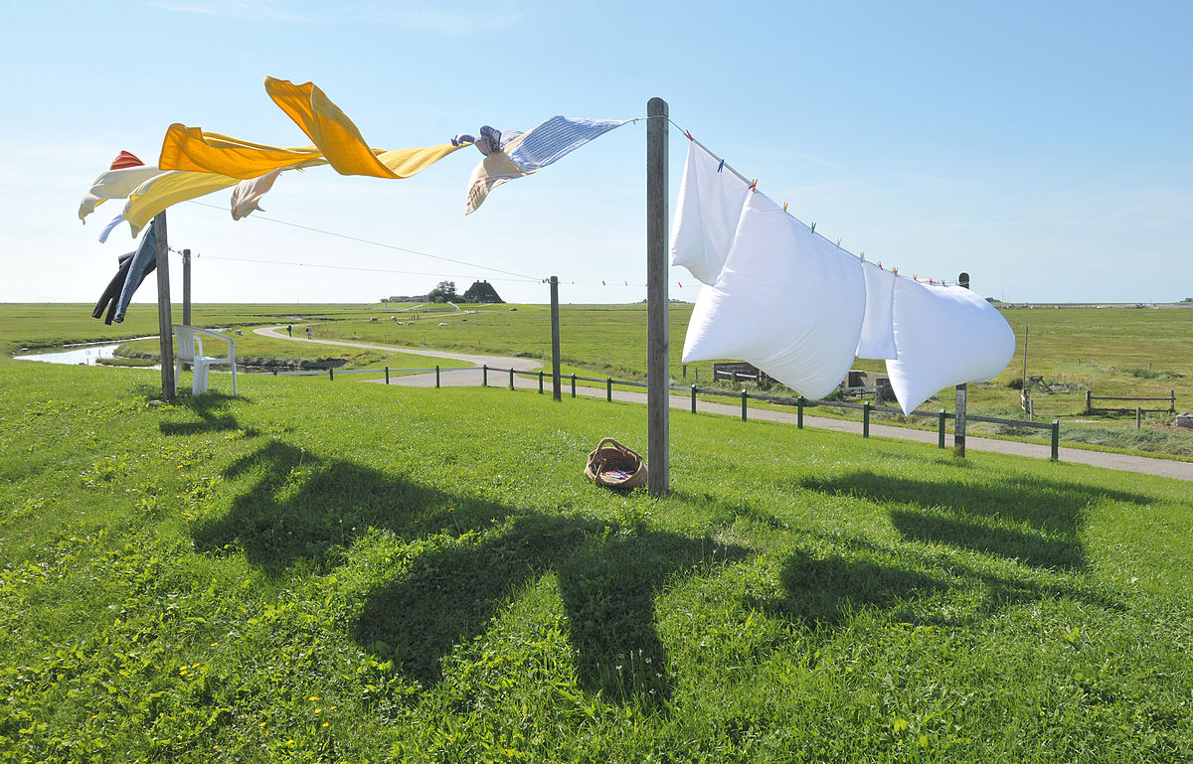
Describing the Position of objects

Slide 11
Describing the position of an object or person
Lying on
Placed on
Laid out
Hung
Stacked
Gathered
Surrounded by

Slide 12
The professions
Learn different types of professions and the names of the places where they work

Slide 13

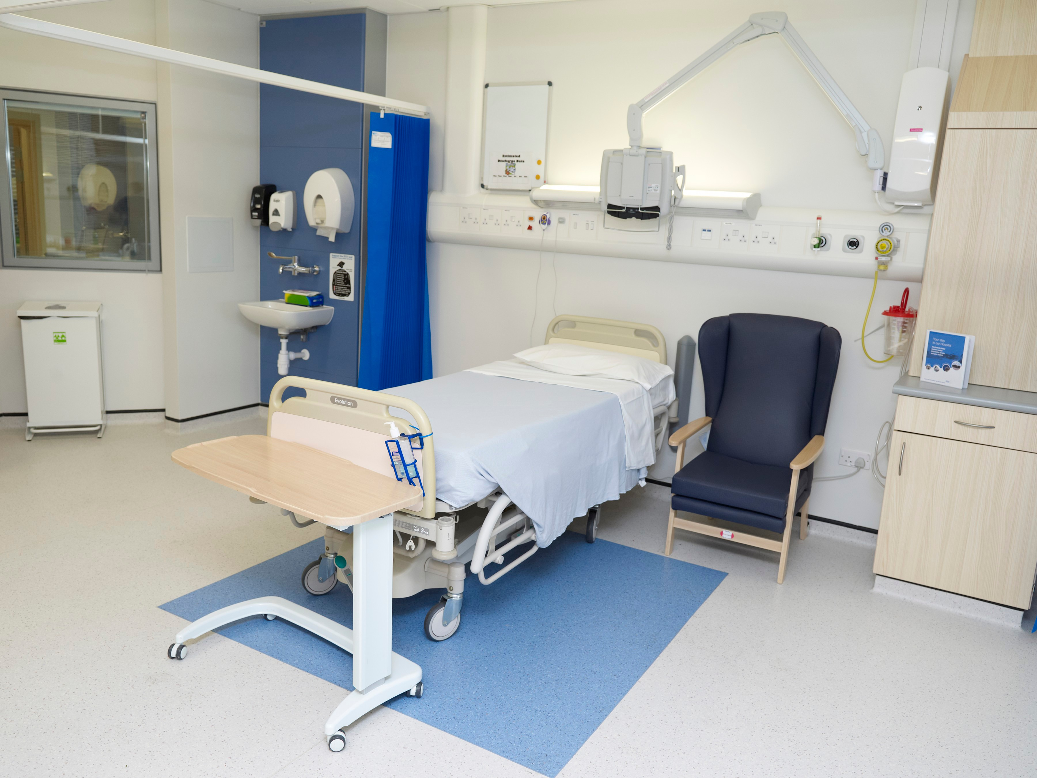
The Professions

Slide 14
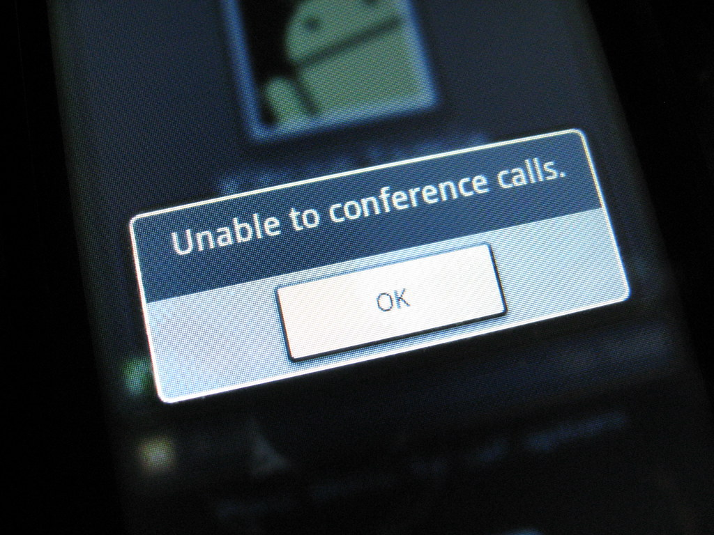
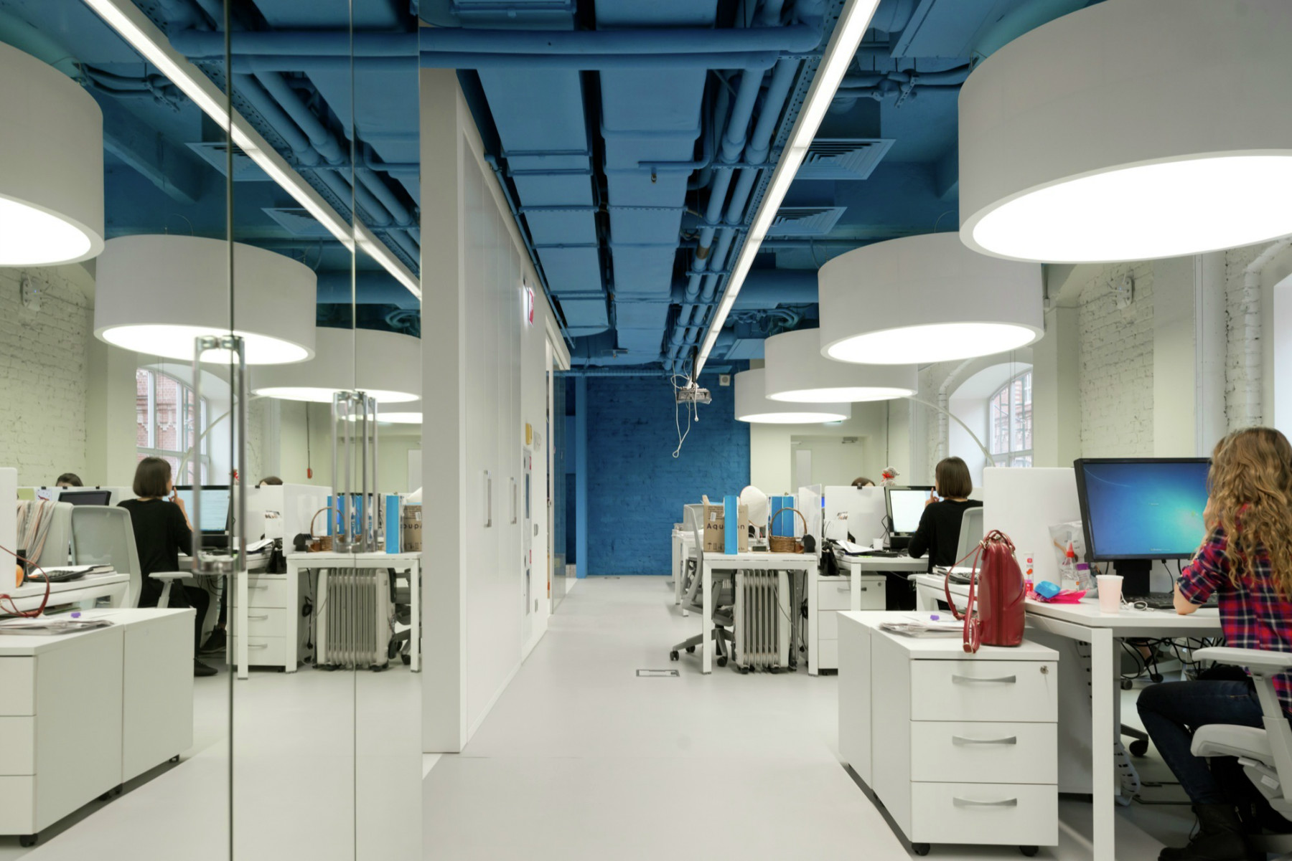
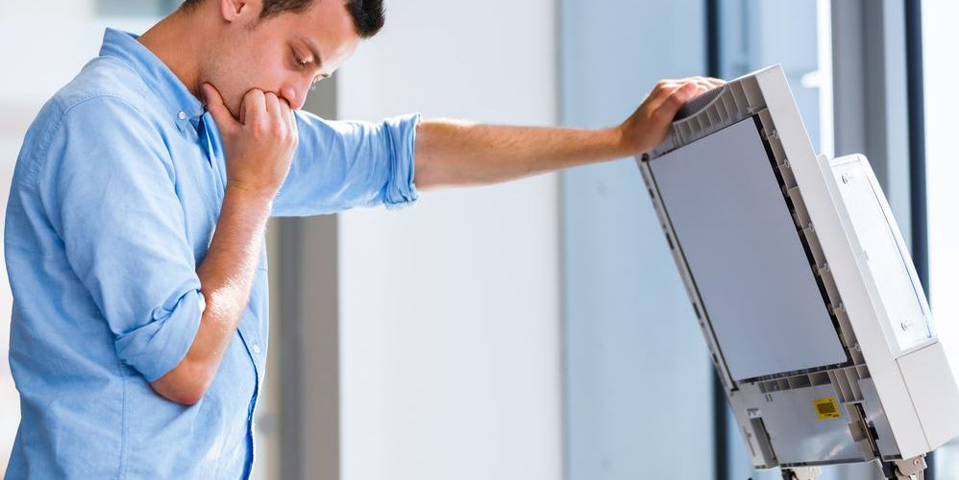
Learn The workplace (TOEIC) vocab list

