Slide 1
Interviews – preparation and techniques
Emma Bowers
ING2
2019/2020

Slide 2
Learning Objectives
To practice your listening and speaking skills
To acknowledge non verbal communication
To learn key phrases and words for an interview in English
To practice speaking English in an interview scenario

Slide 3
How fast do you think we make first impressions?

Slide 4
Seconds

Slide 5
Interview Preparation
Listening and speaking skills

Slide 6
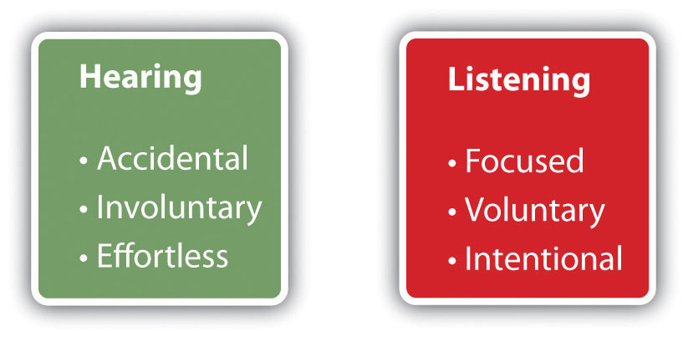
Listening and Hearing Differences

Slide 7
An American English Interview
Watch the following: How to Interview for a job in American English. Rachels English.com on Youtube.
Listen and write down any phrases you want to use for your interview. It is part of a series of videos on interviews. It is basic, but a good starting point if you have never had an interview in English. It will also give you an opportunity to test your listening skills in preparation for your TOEIC exam.

Slide 8

Communication

Slide 9


Verbal Communication – 7%
Words
Speed
Tone
Pitch

Slide 10

Non-verbal communication

Slide 11

Non-verbal communication

Slide 12
Non verbal Communication – 93%
38% Body language – hand position, posture and facial expressions
55% Voice – tone, intonation and volume

Slide 13
Class Exercise
Listen to the following video: Body Language That Gets The Job Forbes. Accessible on Youtube.com
Why are the women explaining the importance of body language?
What are the points they discuss?

Slide 14
Different Types of Interviews
1 : 1
1 : 2
1 : 3 or more
Group
Video
Telephone

Slide 15
Interview formats
Open ended questions
Written tests
Practical tests
Observations

Slide 16
Interview preparation - 1
Read your CV and cover letter
Gain knowledge about the company
Revise the job description

Slide 17
Interview preparation - 2
Practice answering common interview questions in English
Learn and practice in English any specific words or phrases you find difficult to pronounce or write

Slide 18
Interview preparation - 3
Where is the meeting?
Who are you meeting?
What do you need to take with you?
How are you travelling to the interview?

Slide 19
Interview preparation – 4
Body language
Handshake
Voice
Listening and speaking skills

Slide 20
Interview preparation – 5
Video interviews advice plan and consider:
Background noise and environment
PC volume and microphone
Your position

Slide 21
The Interview Day
Silence your phone
Arrive about 10 minutes before your interview time
At the reception desk explain who you are and who you have come to see
Be organised, have your personal documents easily accessible

Slide 22
Expressions and phrases used in interview settings
Interviewer
Interviewee
Pleased to meet you
Please sit down
Welcome to our company
I / We hope you got here ok
It’s nice / good to meet you
Pleased to meet you too
Thank you
Thank you
Yes thanks, if no keep your reason short and professional
It’s nice / good to meet you too

Slide 23
The end of the interview
Ask questions at the end of the interview. Here are some aspects you might question:
Continuing Professional Development (CPD) opportunities
Contract benefits – pension contributions, annual leave entitlements
Working patterns - flexible hours

Slide 24
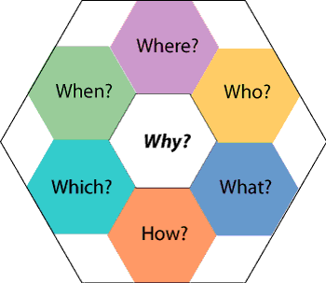
Interrogative Pronouns

Slide 25
Class Exercise
Write 5 questions and answers to an intern or graduate position.

Slide 26
Common interview questions
Can you tell us about yourself?
How did you find out about the position?
What do you know about the company?
Why do you want this job?
What motivates you?

Slide 27
Examples interview questions
What are your professional strengths?
What do you consider to be your weaknesses?
What is your greatest professional achievement?
Tell us about a challenge or conflict you’ve faced at work and how you dealt with it.
Are there any questions you would like to ask us?

Slide 28
Examples of job specific interview questions
25 Cybersecurity Job Interview Questions. DeGroat T.J. (2018). Available at http:/springboard.com (accessed September 2019)
109 Data Science Interview Questions and Answers. Rundell M. (2018). Available at http://springboard.com (accessed September 2019)

Slide 29
How to begin answering the questions
I am motivated by…..
I have experience of…..
My most difficult work challenge was when I…..
My strengths are related to my…..
I would be grateful of this opportunity to use my skills I learnt in my internship (give an example)
I am keen to develop future skills in….. (give an example) which I understand are used in this company

Slide 30
How to answer difficult questions using the STAR technique
Use this acronym to answer the question based on your past experiences.
S - Situation
T - Task or Target
A – Action
R – Result
Reference: www.theguardian.com – Using the Star technique to shine at job interviews: a how-to guide.(10/03/14)

Slide 31
The Interview - key points
Preparation
Professionalism
Positive attitude
Pursue your career

