Slide 1
Finance
Emma Bowers
ING2
20192020

Slide 2

Lesson Objectives
To expand your vocabulary
To advance your listening skills
To advance your reading skills
To prepare you for the workplace

Slide 3

Areas of finance you will study
1. At the bank
2. Investments
3. Budgeting
4. Accounts and taxes

Slide 4


Exercise
Group 1. Finance
Group 2. Money
Group 3. Microeconomics
Group 4. Macroeconomics

Slide 5
Word Definition Exercise
1. Discuss the meaning of the word.
2. Write a definition of your word.
3. Give examples to help describe your definition.
4. Explain your definition to the class.

Slide 6

What is finance?

Slide 7

Finance is………
The management of money, or the money belonging to a person, group or organization.
The management of a supply of money.
The money that a person or company has.
To provide the money needed for something to happen.

Slide 8
definition
Finance – the management of money including investing, borrowing, lending, budgeting, saving and forecasting. It can be divided into three types, personal, corporate and public / government.
(corporatefinanceinstitute.com)

Slide 9
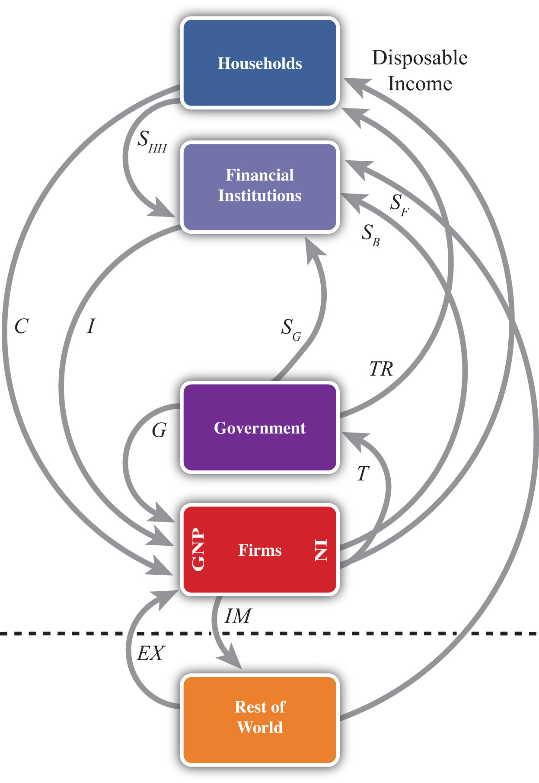
What is the relationship between finance and economics?

Slide 10
What is the relationship between finance and economics?
Finance and economics are interralated and inform and influence each other.
Financial economics – the part of economics that deals with financial markets and shares for example.

Slide 11
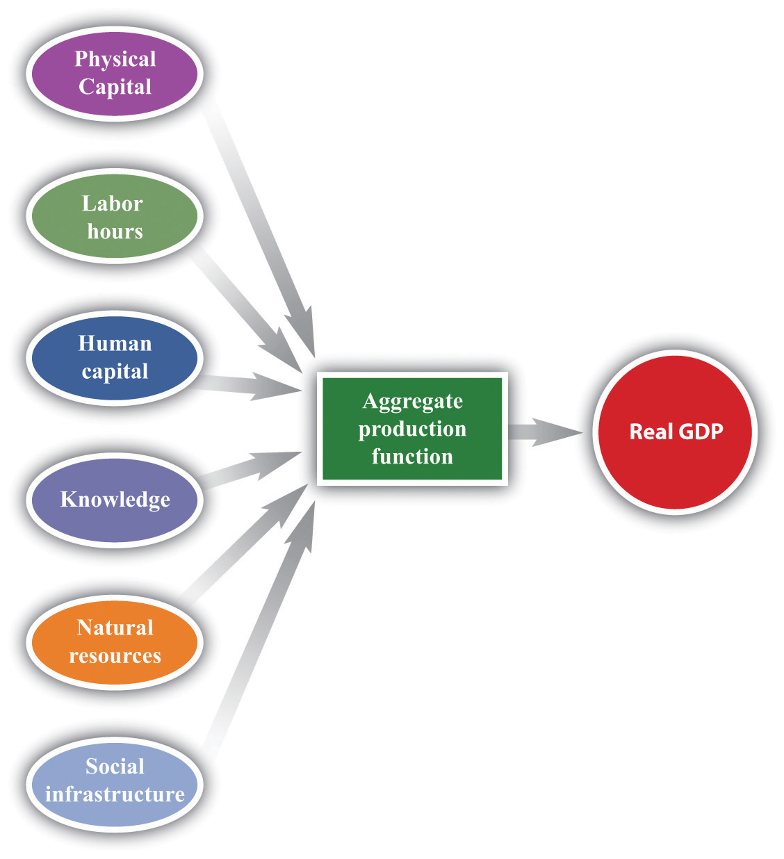
Economics - What is it?

Slide 12
Economics is……
Economics – is the social science concerned with the production, distribution and consumption of goods and services. It studies how individuals, businesses, governments and nations make choices on allocating resources to satisfy their wants and needs. It tries to determine how these groups should organize and coordinate efforts to achieve maximum output (investopedia.com).

Slide 13
What is Microeconomics?

Slide 14
Microeconomics is…….
Microeconomics – the part of economics concerned with single factors and the effects of individual decisions (oxforddictionaries.com). It studies the implications of individual human action about how decisions affect the utilization and distribution of resources. It shows how and why different goods have different values, how individuals make more efficient or more productive decisions and how individuals best coordinate and cooperate with one another (investopedia.com).

Slide 15
What is Macroeconomics?

Slide 16
Macroeconomics is …..
Macroeconomics – the branch of economics concerned with large-scale or general economic factors, such as interest rates and national productivity (oxforddictionaries.com). A variety of economy-wide phenomena is examined such as inflation, price levels, rate of growth, national income, gross domestic product (GDP) and changes in unemployment (investopedia.com).

Slide 17

Money is .…..
Coins or notes that are used to buy things.
The value of what a person or organization, owns, keeps in a bank, has in investments, or spends.

Slide 18

Significant Historical Events
Wall Street Crash of 1929 – when share prices on the New York Stock Exchange collapsed. It followed the London Stock Exchange crash. It signalled the start of a 12 year depression which affected all western industrialised countries.

Slide 19

Significant historical events
The Lehman Brothers – 2008 crash
an investment bank that filed for bankruptcy following a mortgage induced financial crisis.

Slide 20
Want to learn more?
Watch the Ian King show on Skynews
Listen to CNN news – business section
Read ‘The Economist’ (UK) ‘Forbes’ (USA), Financial Times (ft.com)
Access www.CNBC.com
Access www.usatoday.com – money
Access money.cnn.com

Slide 21
Want to learn more?
www.easypacelearning.com – learning the key words used in banking.
Financeintheclassroom.org.
Preply, inc – A list of useful english words and expressions about finance
Banking explained – money and credit – Youtube
Economic Terms explained in One Minute - Youtube

Slide 22
Want to learn more?
The 2008 financial crisis crash course – Youtube
The bank that almost broke Britain – documentary - Youtube
Financial crisis 2008: How Lehman Brothers helped cause ‘the worst financial crisis in history’ (independent.co.uk – 12 September 2018).
Lehman Brothers collapse: How the worst economic crisis in living memory began (telegraph.co.uk – 23 December 2008).
What caused the collapse of the Lehman Brothers? Foxbusiness - Youtube

