Slide 1
ING2 English course information
Teacher: Miss Emma Bowers
Academic Year: 2019 / 2020

Slide 2
Course Objectives
To develop your knowledge of professional and informal English for the workplace
To prepare you for your TOEIC exam

Slide 3
Facts
16 week course
2 hours contact
Homework
TOEIC exercises
Practice TOEIC
TOEIC exam

Slide 4
Behaviours and attitudes
Respect for everyone
Punctuality
Preparation and Participation
Absence

Slide 5
Course content
Syllabus in weeks

Slide 6
Semester One: Week 1
Course Objectives and Course Content
Personal Objectives
Assessment process – tests / exams
TOEIC format
Learning resources

Slide 7
Semester One: Week 2 – 4
Workplace Preparation
CVs and Resumes – what are the differences?
How to write a cover letter that stands out?
What can I do to be successful at interviews?

Slide 8
Semester One: Week 5 - 8
NewTechnologies

Slide 9
end of semester One
December 2019: Mock TOEIC exam

Slide 10
Semester Two: Week 9 - 12
Finance

Slide 11
Semester Two: Week 13 - 16
Globalisation

Slide 12
semester TWO TOEIC Dates
TOEIC Seminar Week:
30/03/20 – 01/04/20
TOEIC Exam: 02/04/20

Slide 13
Assessment
This course involves a continuous style of assessment – you can be assessed at any time in any lesson
Refer to AREL for more details

Slide 14

Areas Assessed
1. Listening
2. Writing
3. Speaking
4. Participation
5. Vocabulary
6. * TOEIC*

Slide 15
Results
The total sum of all your work in each of the 6 areas will be awarded out of 20 for each semester.

Slide 16
TOEIC
Test of English for International Communication

Slide 17
Why?
The Commission des Titres d’Ingenieurs (CTI) specifies “a minimum level of English proficiency is required for a student to be awarded an engineering degree.”
“engineers need to be able to use technology most effectively in an international context.” (www.etsglobal.org, 2018)

Slide 18

TOEIC
Identify your own learning needs
Put together your own learning resources
Understand the TOEIC exam format

Slide 19
TOEIC Format
Listening comprehension
Includes 100 questions
Test time is 45 minutes
Areas tested are:
Photographs
Question – response
Conversations
Short talks
Reading comprehension
Includes 100 questions
Test time is 75 minutes
Areas tested are:
Incomplete sentences
Error recognition or text completion
Reading comprehension

Slide 20

Toeic ToPICS
THE WORKPLACE:
jobs
human resources
work events
renumeration and contracts

Slide 21

TOEIC TOPICS
TECHNOLOGY:
equipment
the internet
correspondance
calling the helpdesk

Slide 22

TOEIC Topics
FINANCE:
at the bank
investments
budgeting
accounts and taxes

Slide 23

TOEIC Topics
SALES:
retail
ordering
invoicing
delivery

Slide 24

TOEIC TOPICS
TRAVEL:
travel for work
air travel
hotels
car rental

Slide 25

TOEIC TOPICS
HEALTH:
at the doctors
other health professionals
At the pharmacy
healthy living

Slide 26

TOEIC TOPICS
ENTERTAINMENT:
visits
restaurants
vacations
leisure activities

Slide 27
Learning methods & Resources

Slide 28
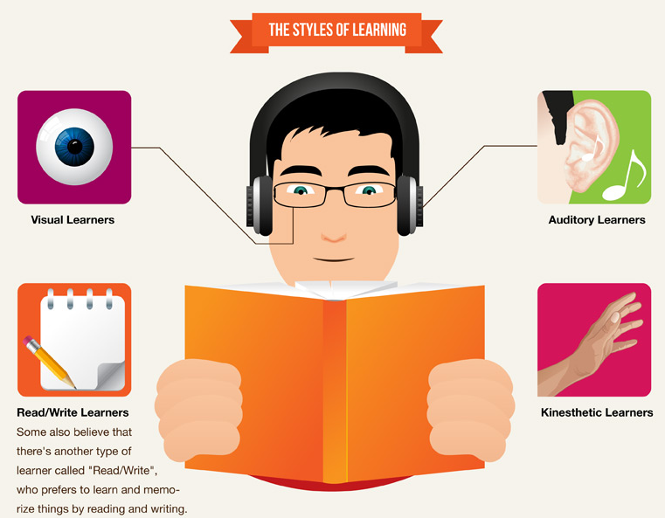

Slide 29


Slide 30
Learning tools
Online resources
Online newspapers
TV
Radio
Group discussions

Slide 31
Useful Dictionary and Thesaurus References
Oxforddictionaries.com (Oxford University Press – English, American English)
Collinsdictionary.com (HarperCollins Publishers)
Cambridge Dictionary (dictionary.cambridge.org)
Merriam-Webster.com (American English dictionary)
Macmillan dictionary (American English or British English)
Australian National dictionary
Macquarie Dictionary (Australian)

Slide 32
Useful websites
Englishclub.com
Ets.com educational teaching system

Slide 33
Useful online resources for learning
CNN
WashingtonPost
BBC
News.sky.com
The Times
The Guardian
The Telegraph
The Economist
France24.com

Slide 34

Questions

